Slide 1

SAXS and SANS data analysis with
WojCIECH Potrzebowski
wojciech.potrzebowski@ess.eu

Slide 2
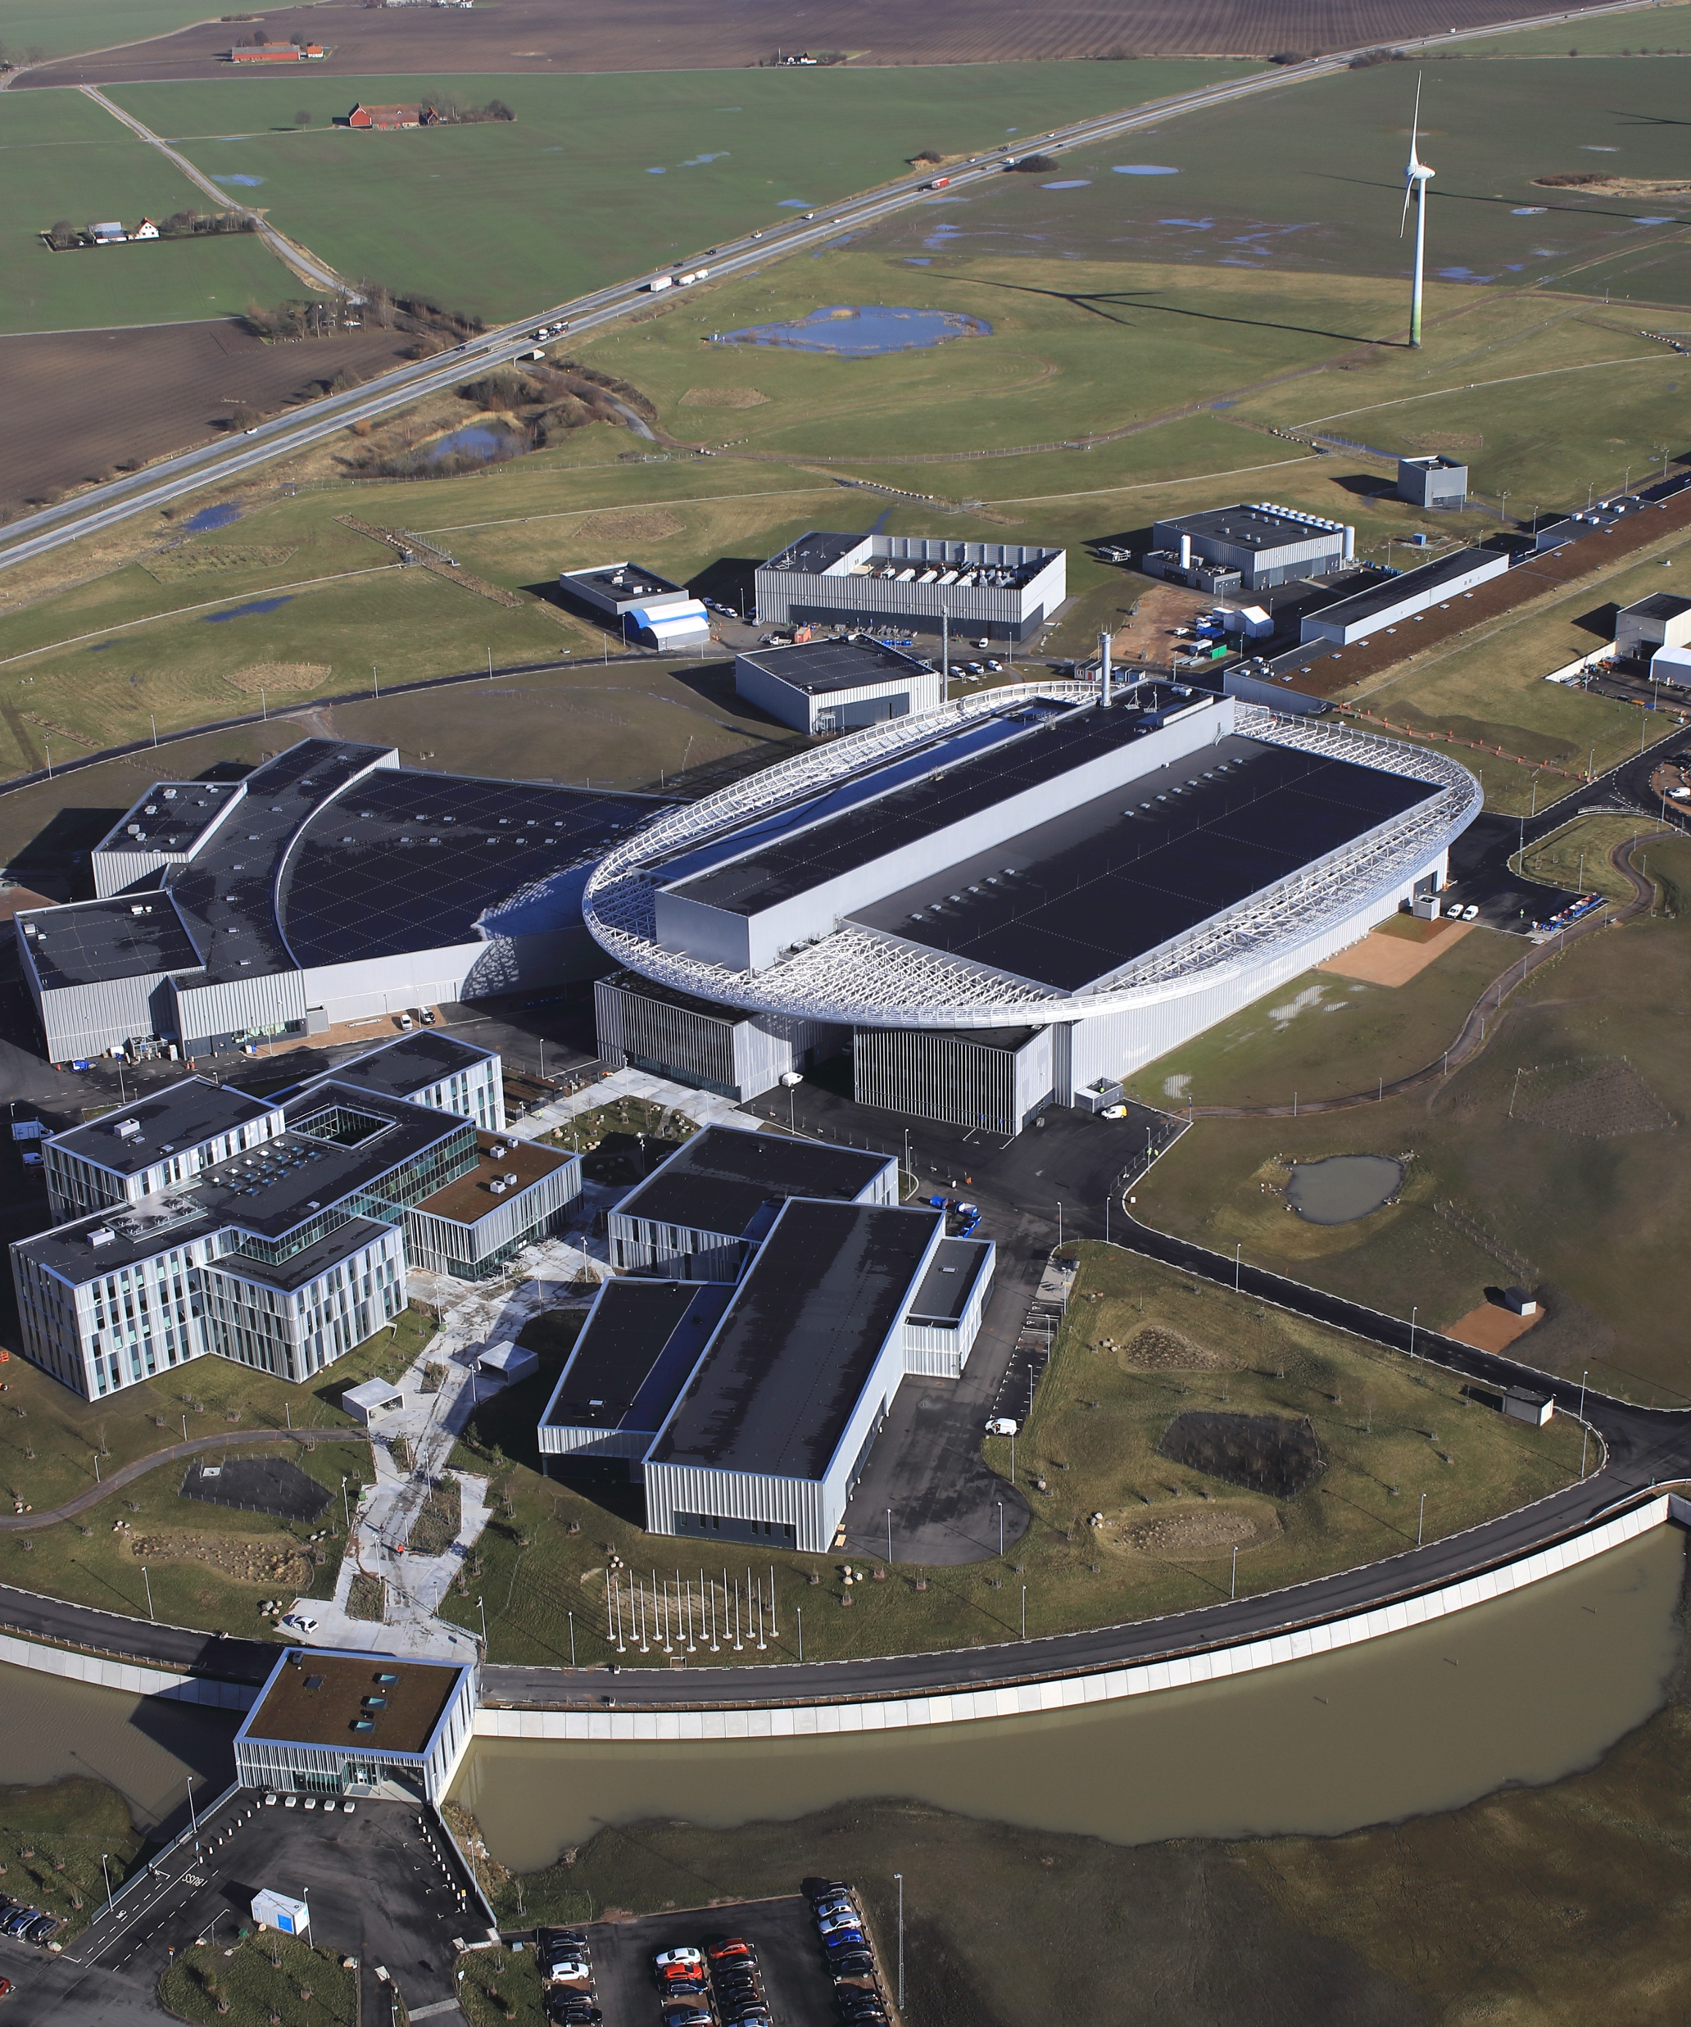
ESS
European Spallation
Source

Slide 3
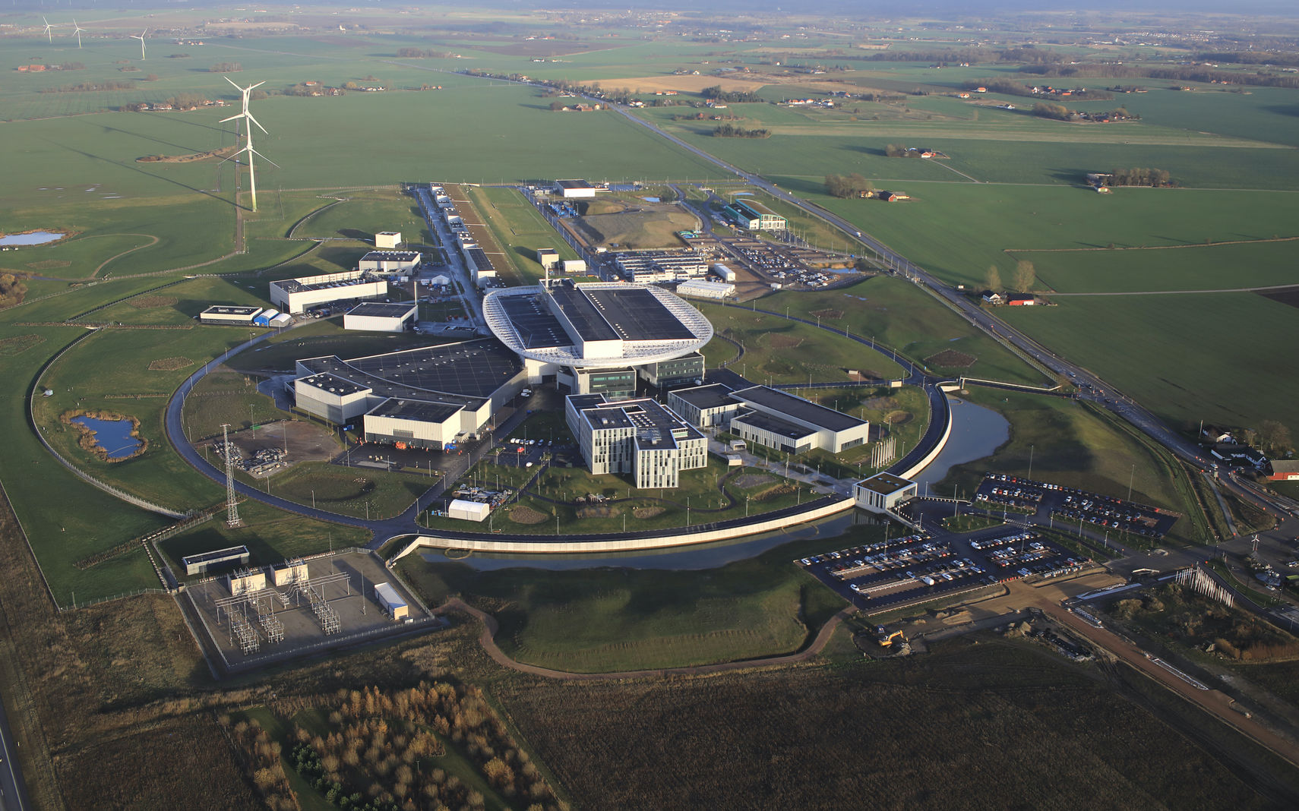
ESS - Road to Science
European Research Infrastructure Consortium
13 member countries
2026
User program up and running
2014
Construction starts on green field site
2025
Beam on target
2009
Decision to site ESS in Lund
2019
Start of initial operations phase
2012
ESS design update phase complete
2003
European design of ESS completed

Slide 4
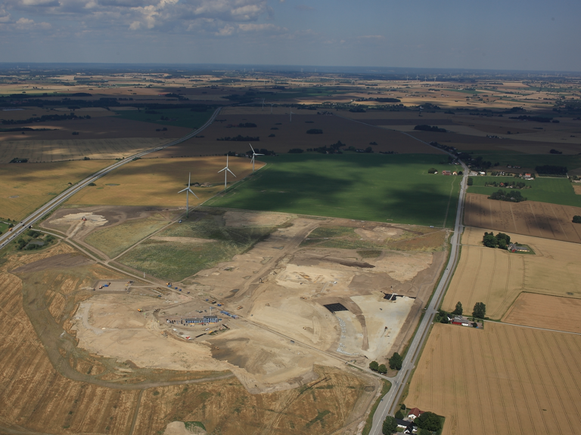
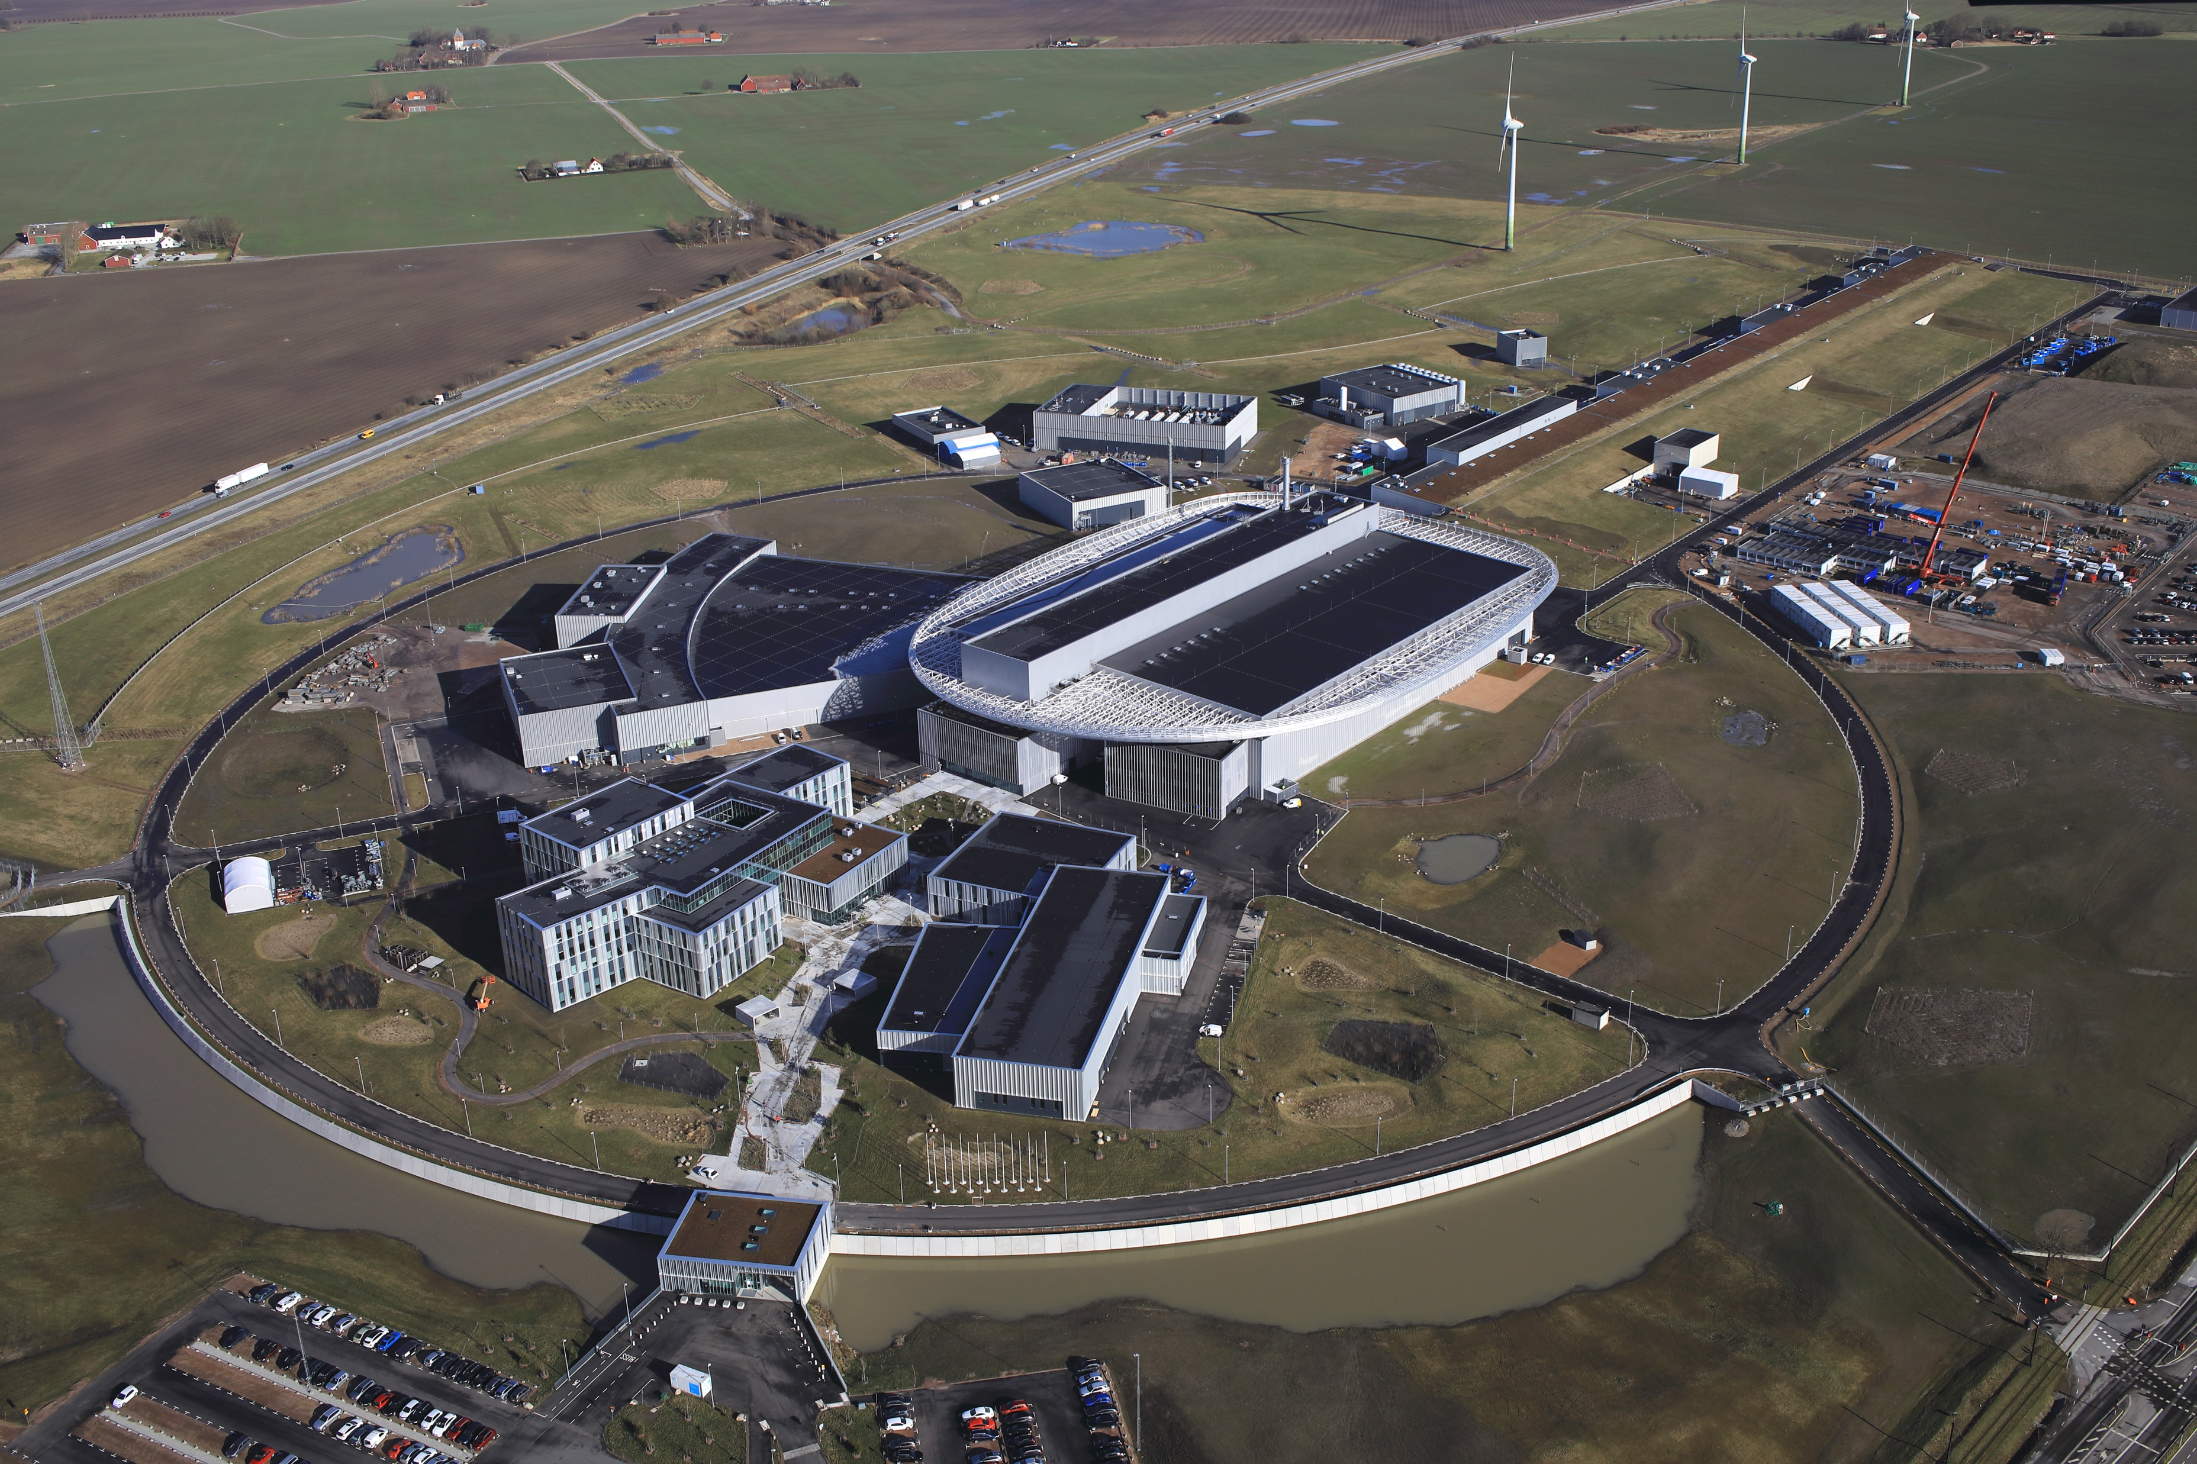
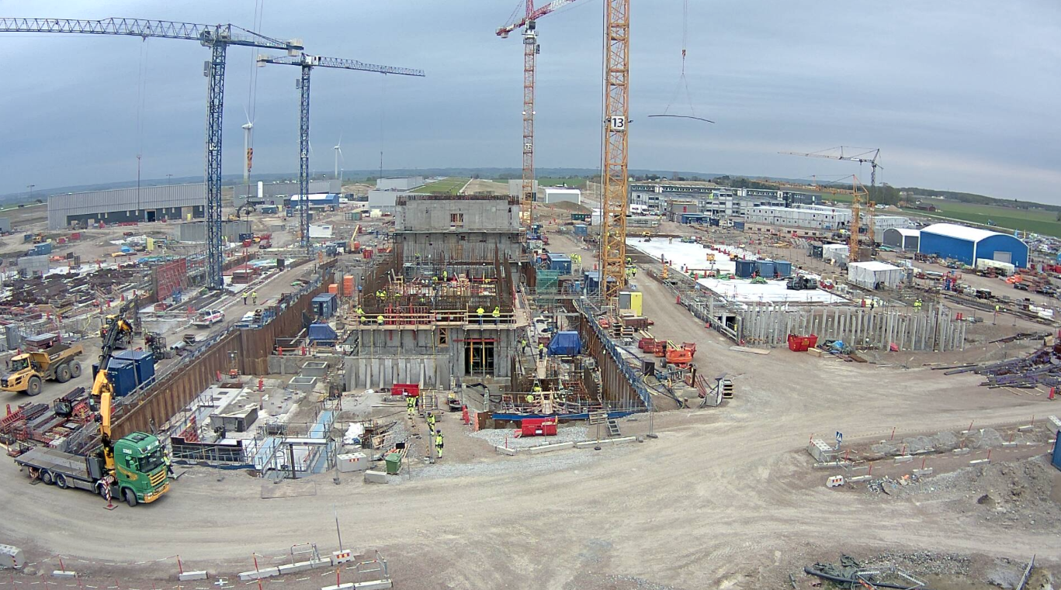
Emergence of a powerful neutron source
In Lund, Sweden
Sept 2014
April 2020
Feb 2022
April 2020
April 2018

Slide 5
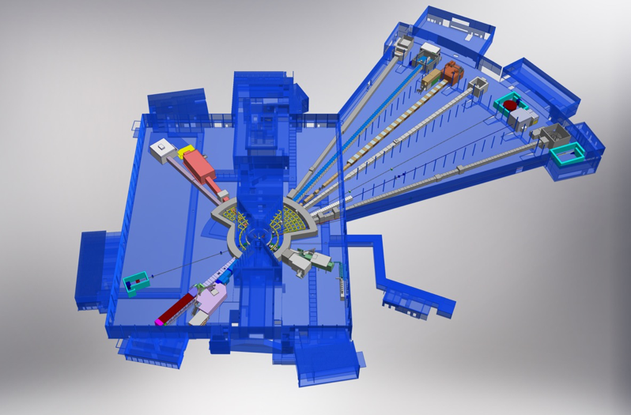





Data Management and Software Centre
Danish Entity of ESS
NMX
BEER
CSPEC
BIFROST
TO DO:
Scientific
computing
for this
MIRACLES
MAGIC
DREAM
ODIN
ODIN
T-REX
DREAM
HEIMDAL
VESPA
LoKI
VESPA
ESTIA
FREIA
SKADI
ESTIA
SKADI
ESS Instrument Layout (September 2017)
15 instruments for materials research with neutrons
Data
Management &
Software
Centre

Slide 6
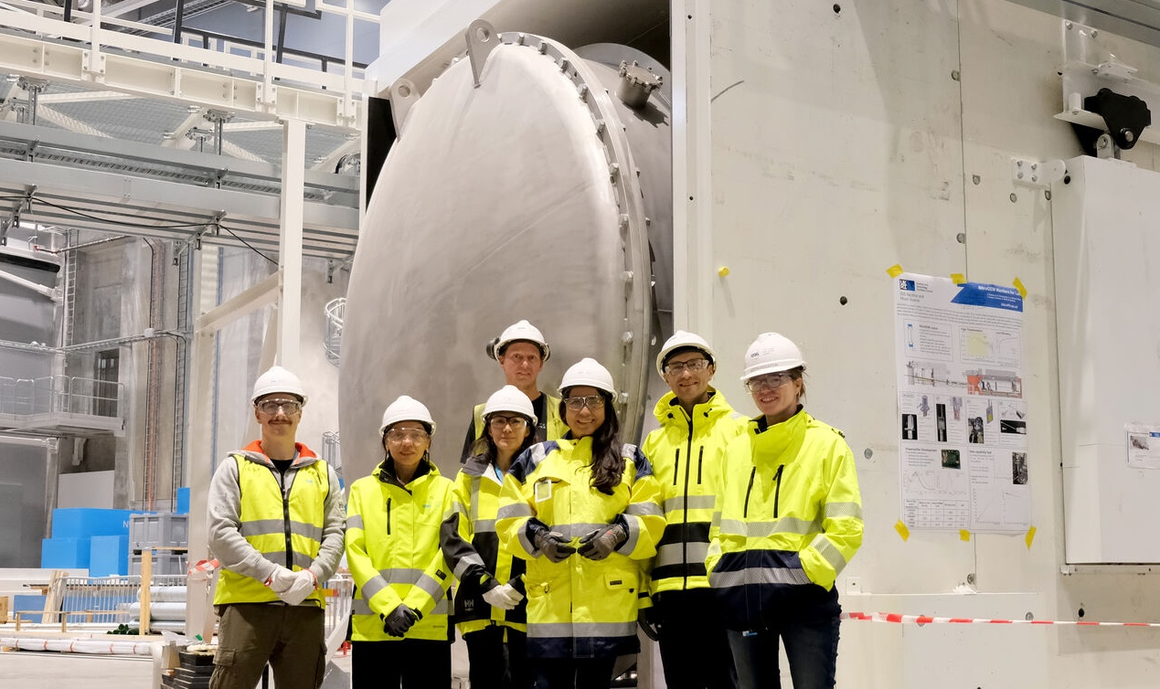


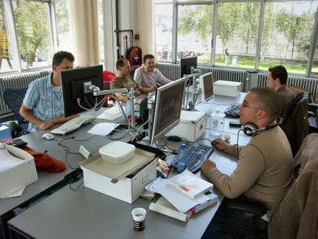
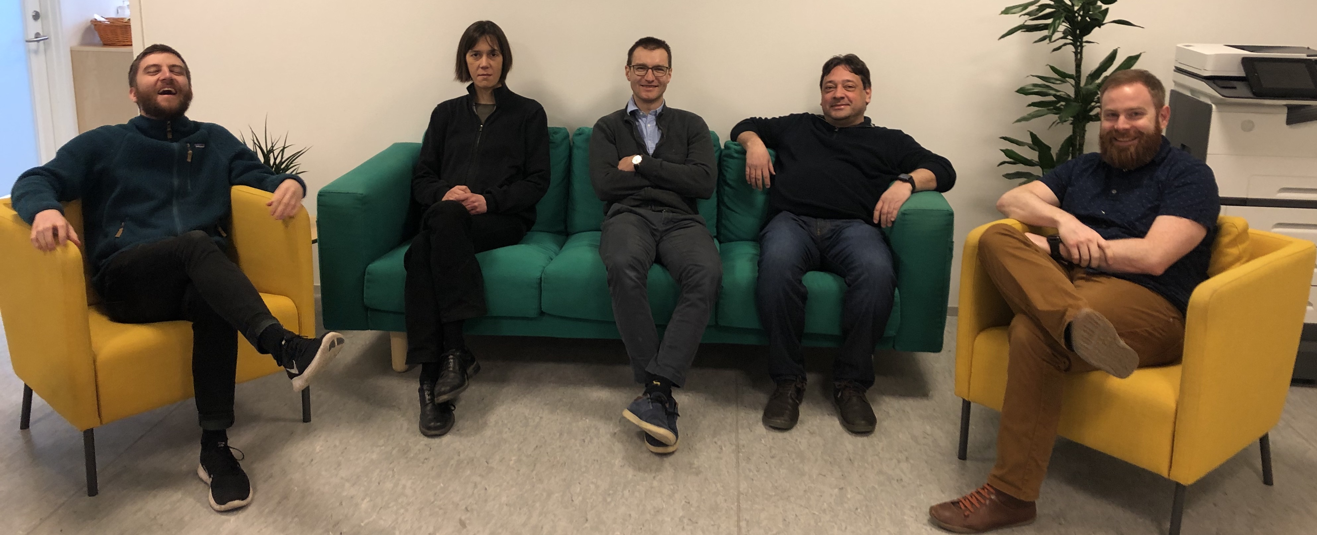



Instrument data scientist role
Instrument team
Instrument Data Scientists
DMSC
Users

Slide 7
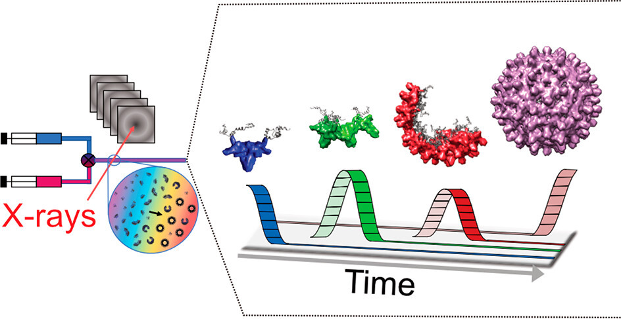
IDSes also have a scientific profile
In my case...
Self-assembly
Viruses
Bayesian statistics
Atomistic simulations
Multimodal analysis
SasView
In collaboration with Lund and Copenhagen Universities

Slide 8
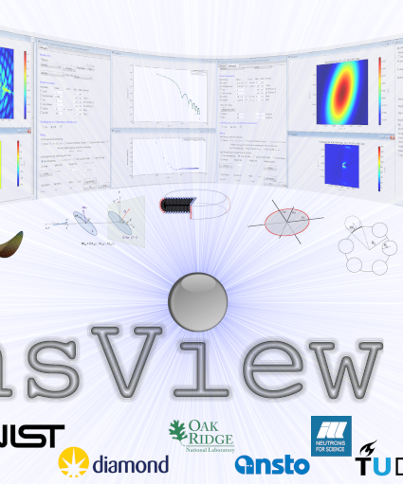
SasView
Toolbox for SAXS and SANS data analysis

Slide 9


User Journey
Data reduction
From idea to results
Experiment control
Data streaming
Data analysis
User Office Software
Before experiment
During experiment
During and after experiment

Slide 10
User Journey
Facility
Responsibility+Expertise
Users
User Office Software
Experiment control
Data streaming
Data reduction
Data analysis

Slide 11
Data analysis
Facts of life
Data analysis is part of the processing workflow
Reduced data on the disks is useless
Users expertise is critical for successful data analysis
Facilities should support data analysis software but shouldn’t fully drive the process
->We need open and collaborative software tools in order to succeed!

Slide 12
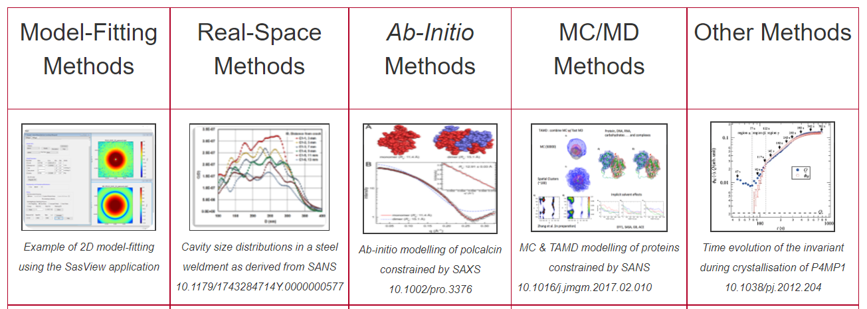
Data analysis
Few different options for SAS data
Not in SasView scope
https://www.isis.stfc.ac.uk/Pages/SANSdataanalysisOverview.aspx

Slide 13
Typical SasView workflow
For reduced data:
Load and plot experimental data
Define a model (form and structure factor) with parameters
Fit the parameters so that model matches experimental data
Draw scientific conclusions and publish results!

Slide 14
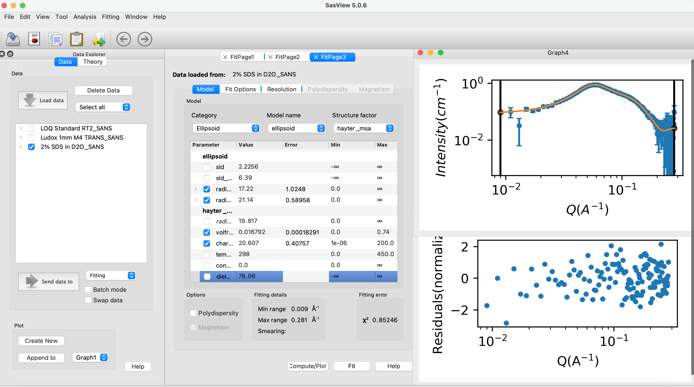
Fitting in SasView
70+ models to explain data
Wide choice of built-in models (> 70)
F(Q), S(Q) & F(Q)*S(Q)
Single, batch and simultaneous 1D and 2D fitting
Data management
Common data formats supported, including NXCansas & cansas1D
Analysis Tool Choice
&
Plotting
Polydispersity (choice of distribution and distribution parameters)
Resolution smearing (pinhole and slit)
Automatically from data or provide parameters

Slide 15
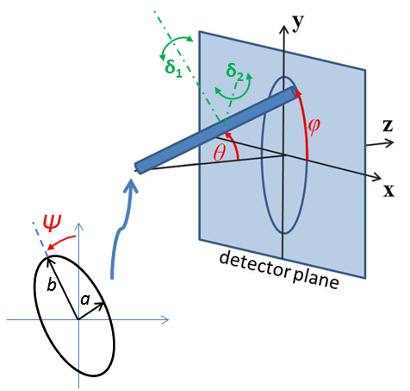
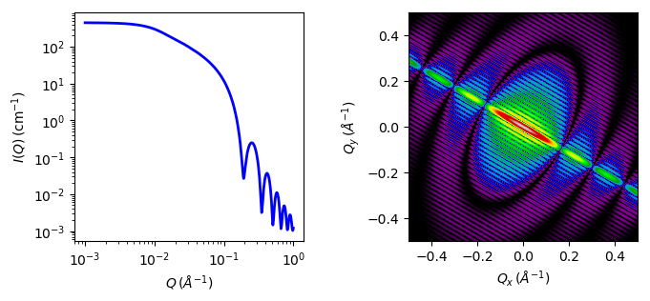
2D fitting
For oriented or magnetic particles
1D and 2D cylinder model

Slide 16
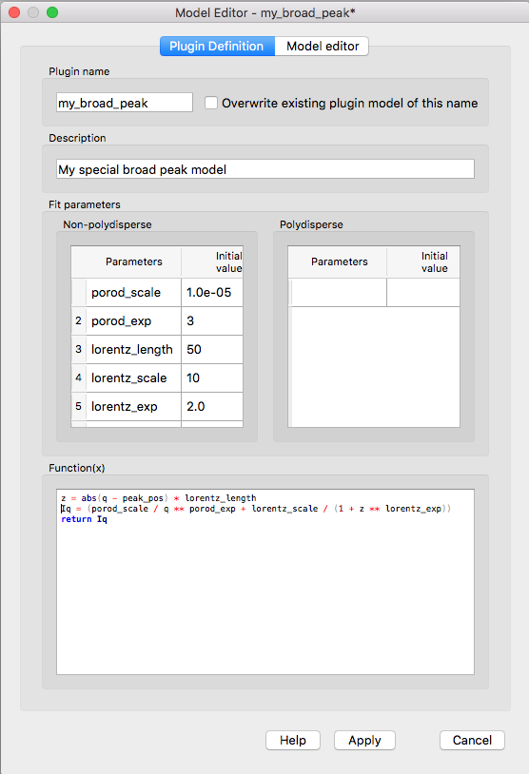
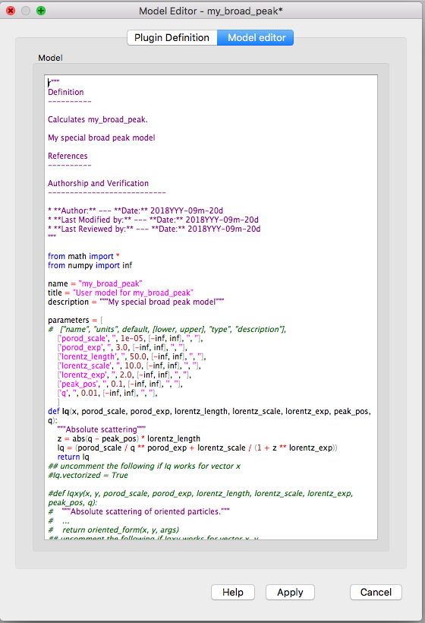
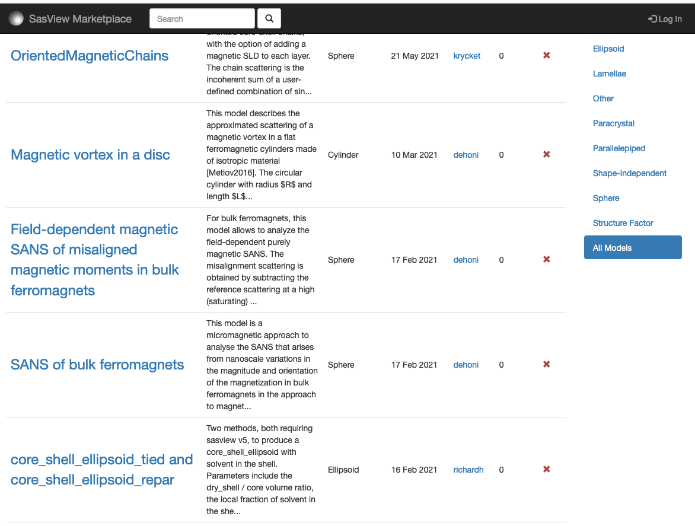
Plugin models
SasView provides tools and infrastructure for custom/plugin models
Dedicated editor
Syntax and performance testing
Directly available in SasView ecosystem
Community developed models can be deposited to marketplace: https://marketplace.sasview.org/

Slide 17
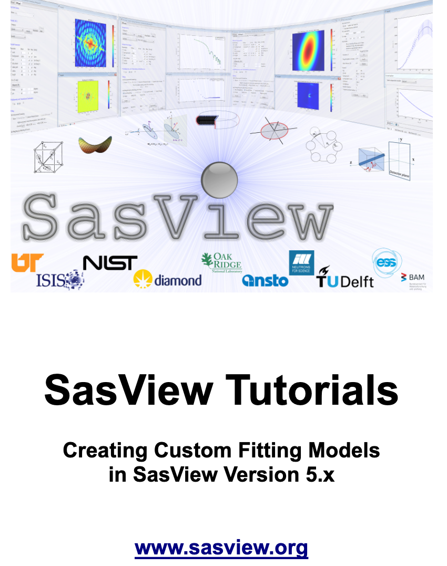
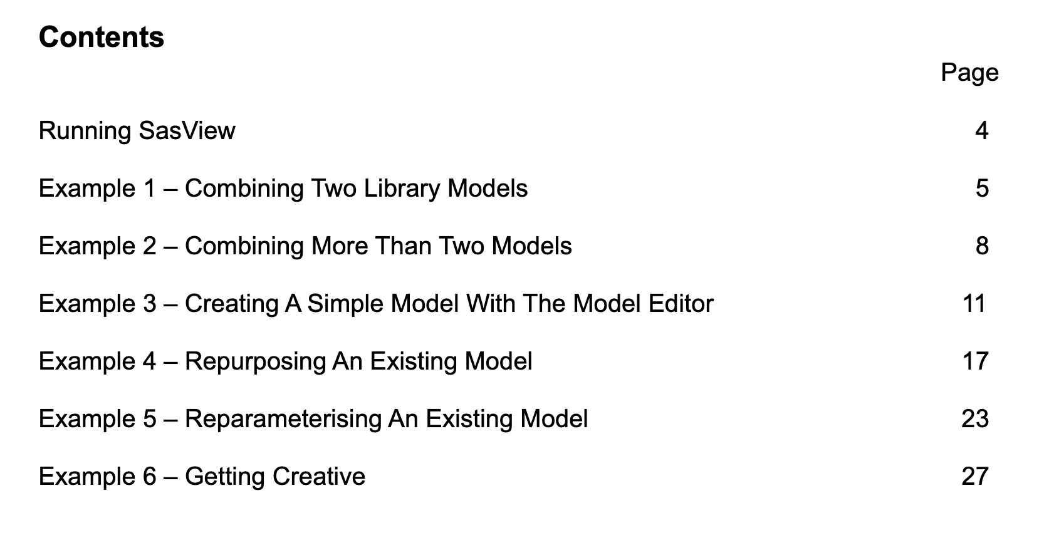
Plugin models tutorial
Available at https://www.sasview.org/download/

Slide 18
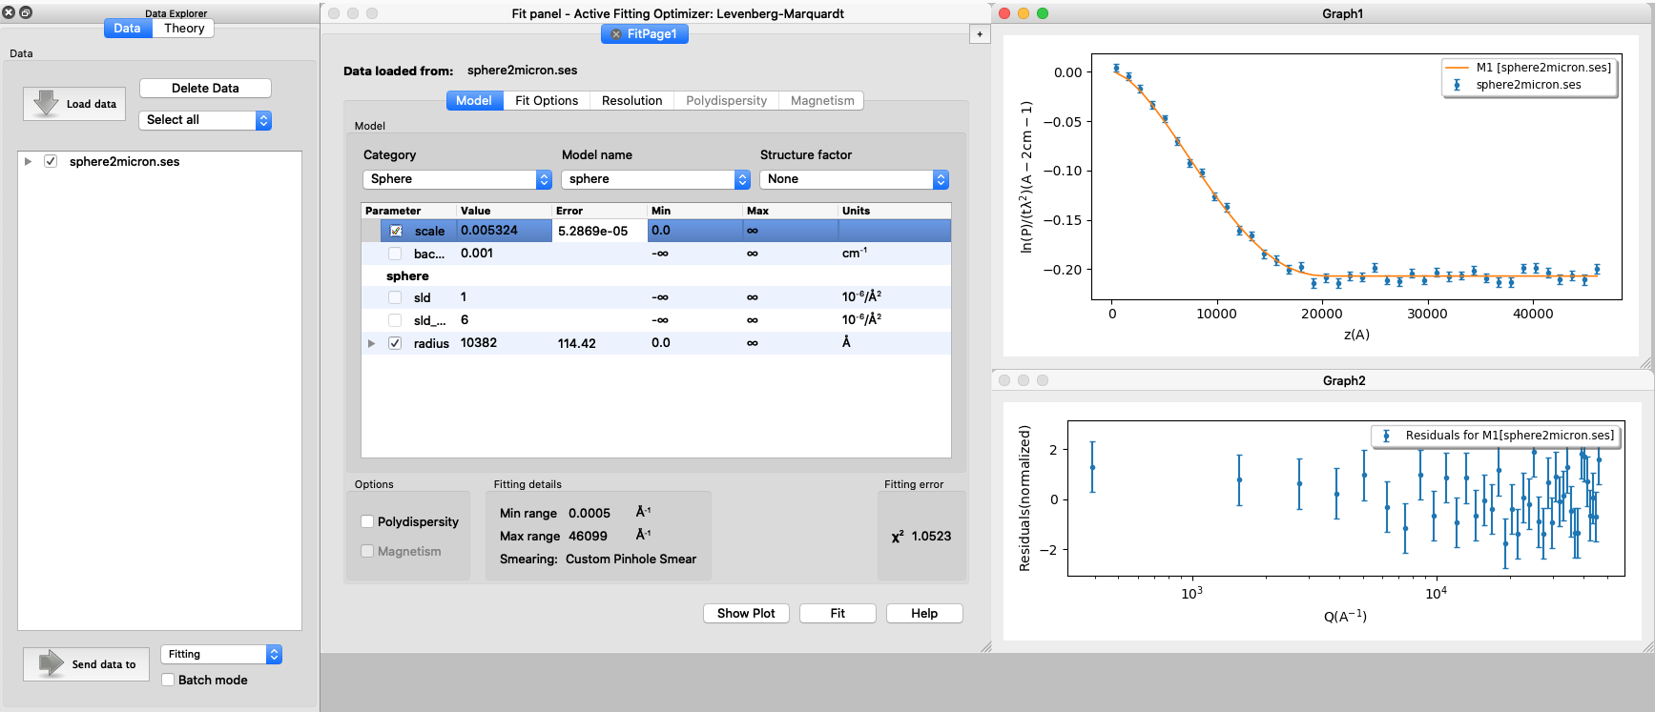
SESANS data
SasView provides functionality for analysing SESANS data
SasView recognizes SESANS data and starts specific workflow
Automatic Hankel Transform of SANS models
Access to all SasView models

Slide 19
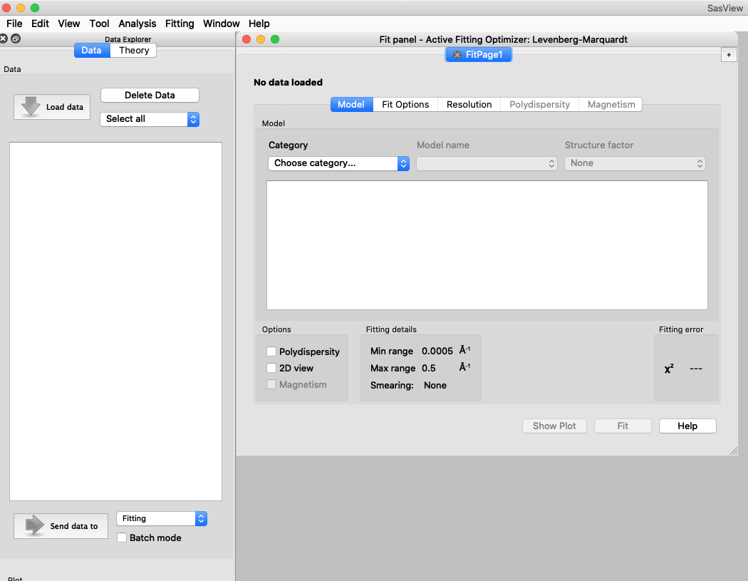
Other SasView functionality
Various utility tools and calculators
Tools
Data Operation
SLD calculator
Density/Volume calculator
Slit Size Calculator
Kiessig Thickness Calculator
Q Resolution Estimator
Generic Scattering calculator
Orientation Viewer
Python Shell/Editor
Image Viewer
File Converter
Analysis
Fitting
Invariant
Pr Inversion
Correlation Function

Slide 20
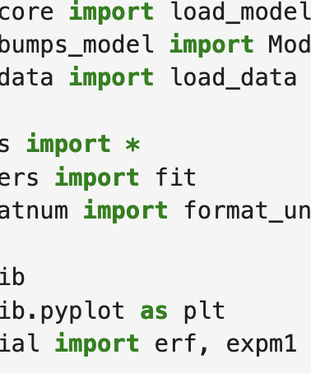
SasView
Running from the script

Slide 21
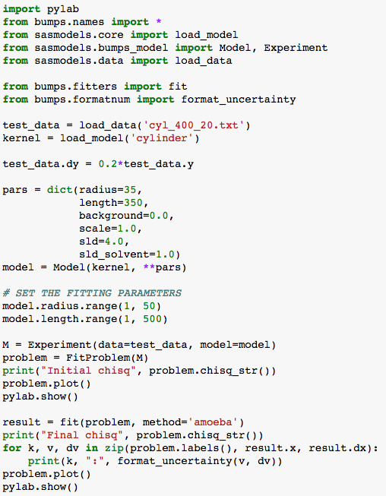
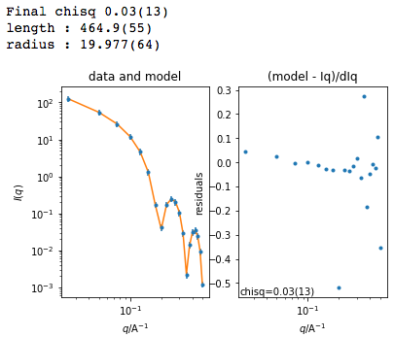
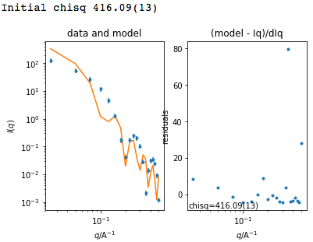
Beyond Graphical User Interface (GUI)
Running SasView from script
Useful for batch jobs and reproducibility
Scripts can be run on computer cluster
Before fit
After fit

Slide 22
Beyond Graphical User Interface (GUI)
How to start?
sasview
sasdata
sasmodels
bumps
Python installation
For fitting, there is no need to install sasview
Pip install sasmodels sasdata
It can be run on computer clusters (also with GPU)

Slide 23
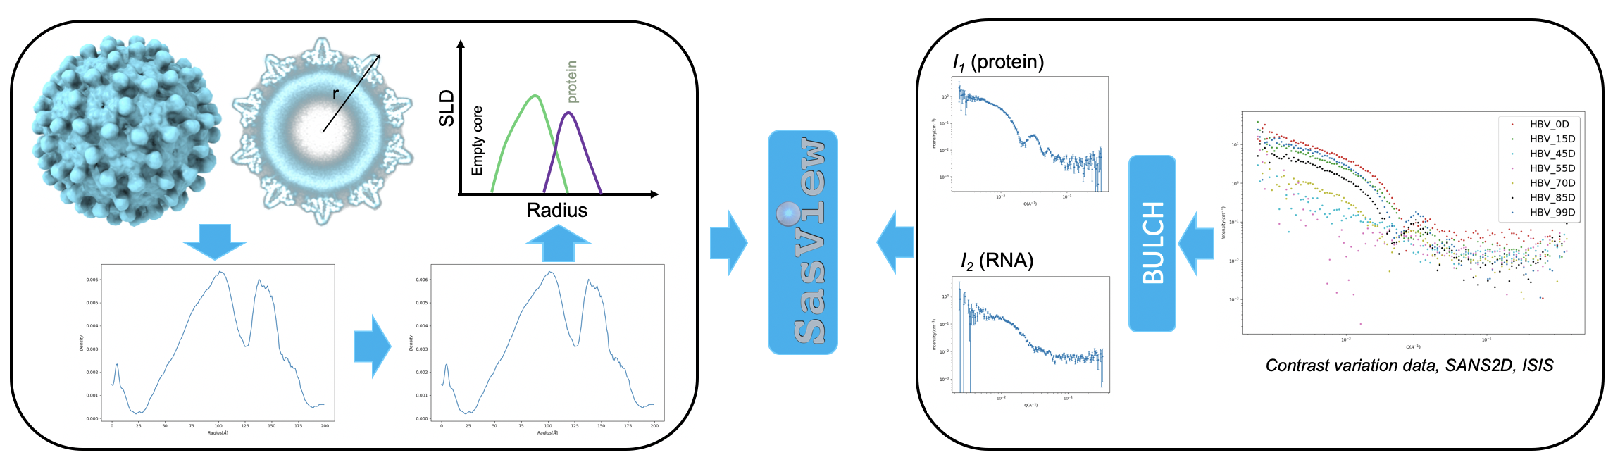
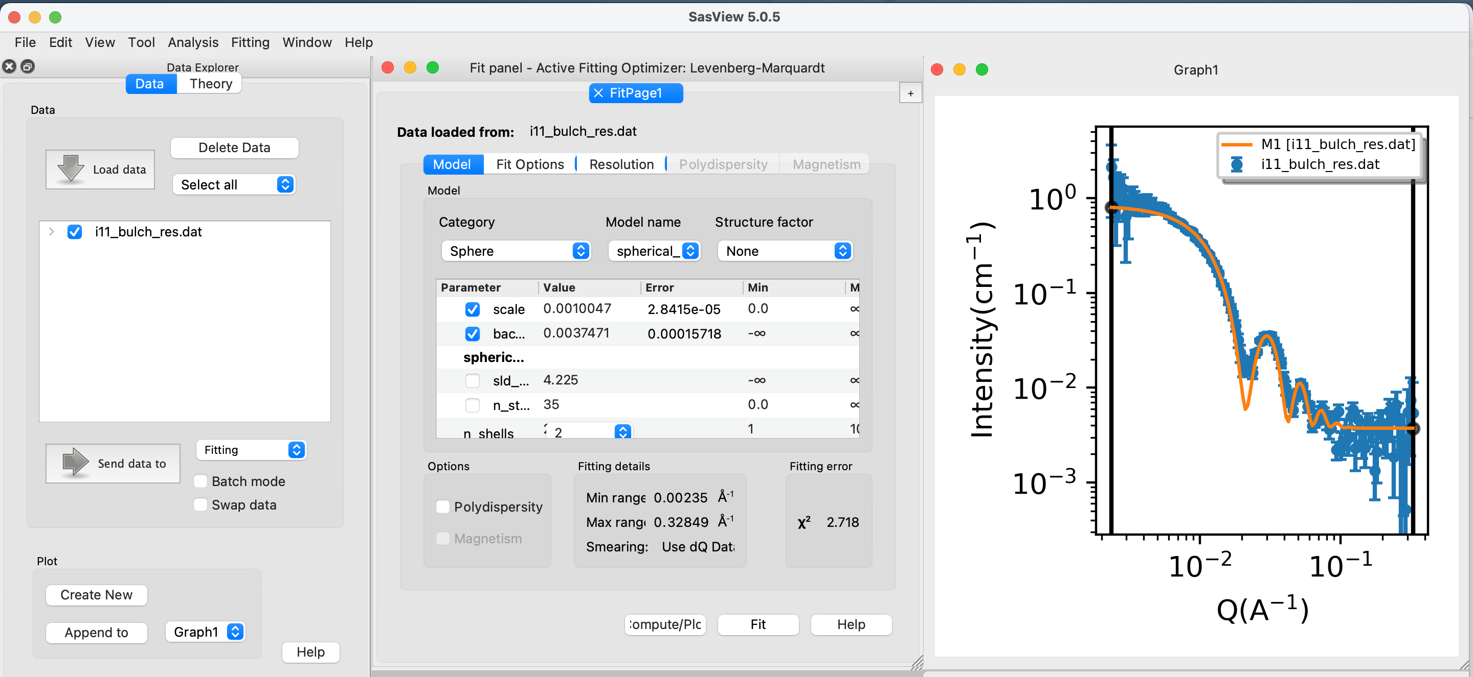
Beyond Graphical User Interface (GUI)
Interchangeable workflows
script
script
GUI
GUI

Slide 24
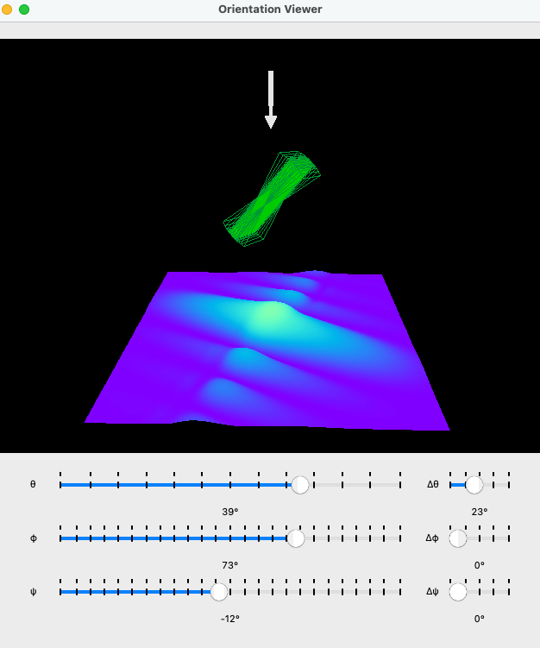
New features
SasView 6.0.0 and beyond

Slide 25
Student projects
Summer 2022 and 2023
Simultaneous SAXS and SANS fitting- Iestyn Cadwallader-Jones, supervisor: Miguel Gonzales (ILL)
Plotting improvements, benchmarking for hypergeometric functions- Nouhalia Agouzal and Dorian Lozano, supervisor: Miguel Gonzales (ILL)
Wedge slicer and improving slicer code - Ellis Hewis, supervisor Dirk Honecker (ISIS)
Extending scattering calculator for magnetic systems – Ruben Lopes, supervisor Dirk Honecker (ISIS)
Extending scattering calculator for Interacting bio-molecules – Alex Zheng, supervisor Yun Liu (NIST)
Local documentation generator and editor (plugin models) – Brayden Miller, supervisor Paul Butler (NIST)
Web-based API, Xael Shan, supervisor Jeff Kryzwon (NIST)

Slide 26
Combined SAXS and SANS
Simultaneous measurements on the same sample
Running at D22 instrument at ILL
Low-flux SAXS source
Specialized sample environment
Non-trivial data analysis
SasView (6.0.0) provides a weighting mechanism in simultaneous fitting
Notes:
High-energy gamma radiation gives rise to backgrounds

Slide 27
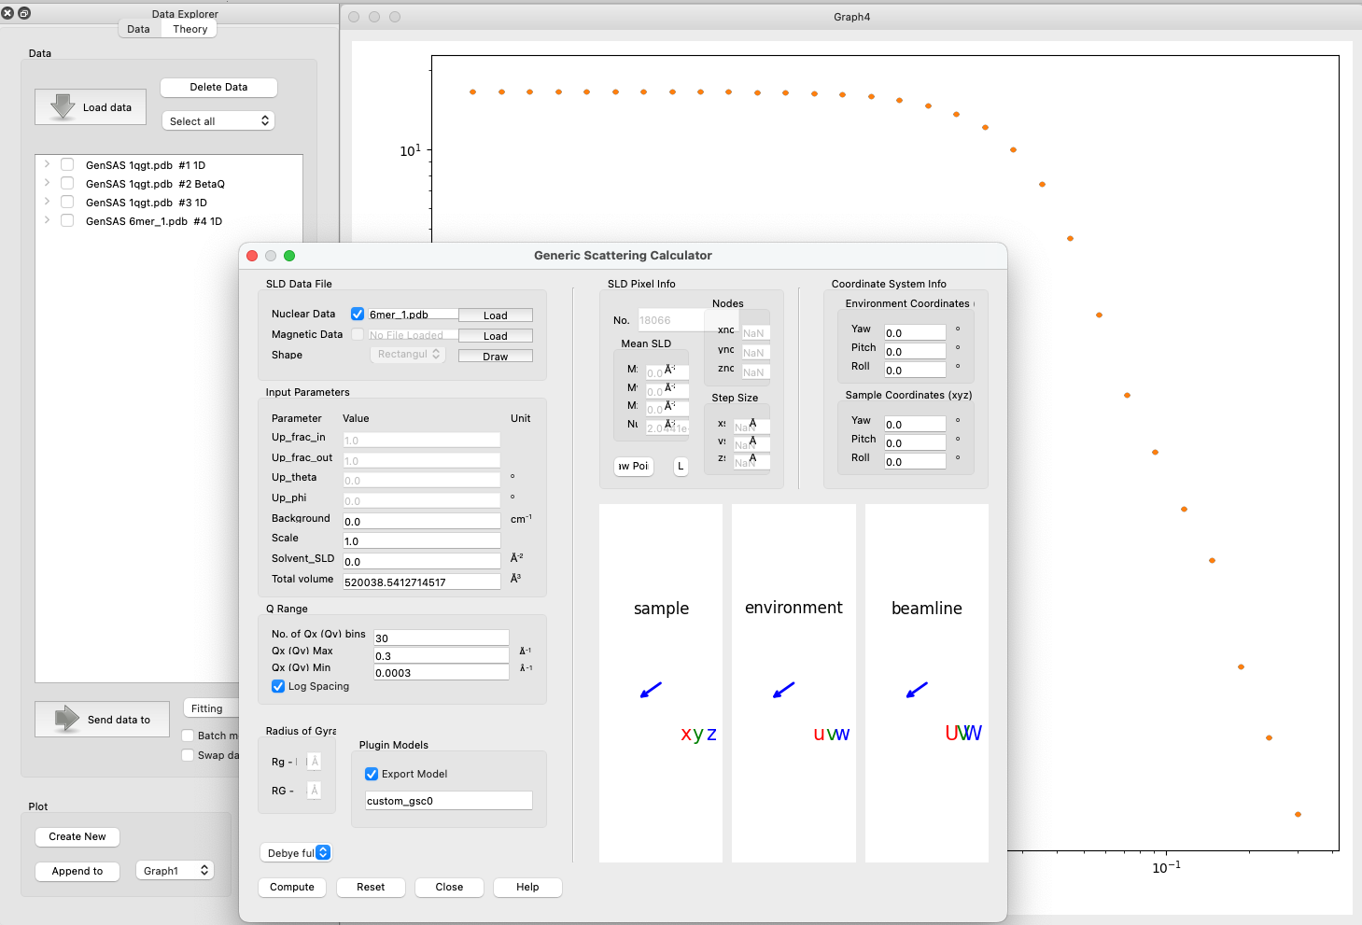
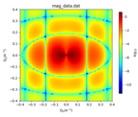
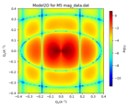
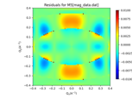
Generic Scattering calculator improvements
Available in SasView 5.0.6
Magnetic/polarized SANS
Generic Scattering Calculator supports magnetic/polarized SANS
Coordinate data in VTK formats supported
Interacting bio-molecules
Generate scattering profile from PDB file
Save as a custom/plugin model
Use for fitting with structure factors (including beta approximation)
(PDB reader and engine refactored)
(No hydration layer)
https://github.com/SasView/sasview/releases/tag/v5.0.6
https://github.com/SasView/sasview/releases/tag/v6.0.0-alpha

Slide 28
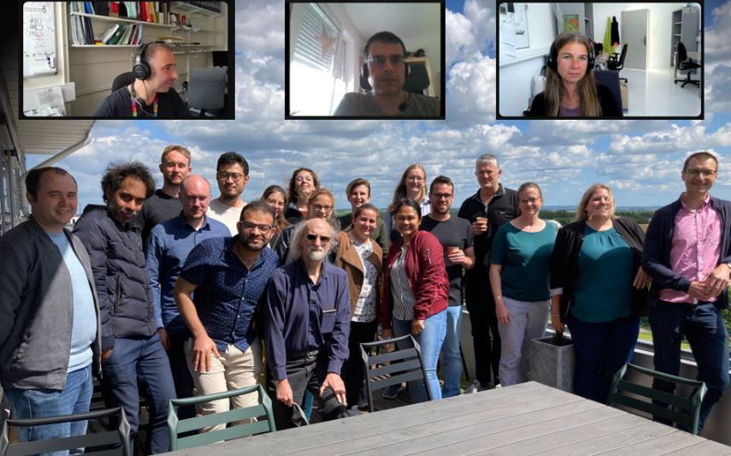
Magnetic SANS workshops
2-day in-person workshop in 2022
1-day follow-up hybrid workshop in 2023
Participants from universities and facilities
Gather requirements for Magnetic SANS data analysis
A number of GitHub issues created
Ongoing work on slicers and porting MuMag functionality (Michael Adams, Univ. of Luxembourg)
Trying to arrange student projects
https://www.tandfonline.com/doi/full/10.1080/10448632.2022.2126691
Credit: Annika Stellhorn (ESS)
https://www.linxs.se/events/2023/1follow-up-magnetic-sans-data-and-software-h4crj

Slide 29
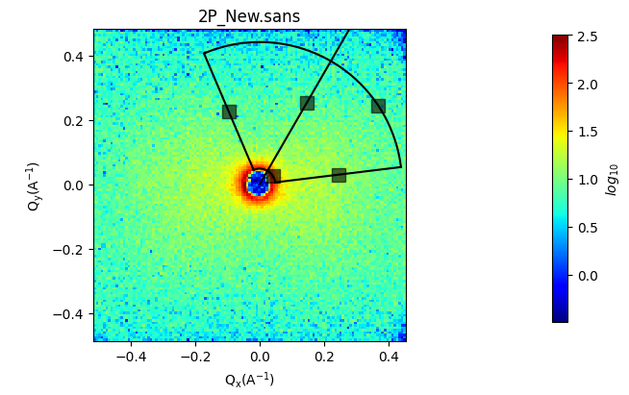
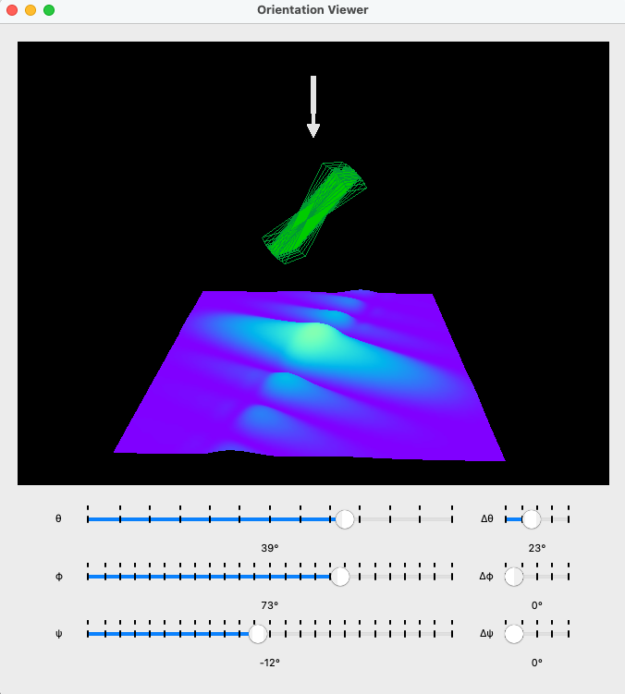
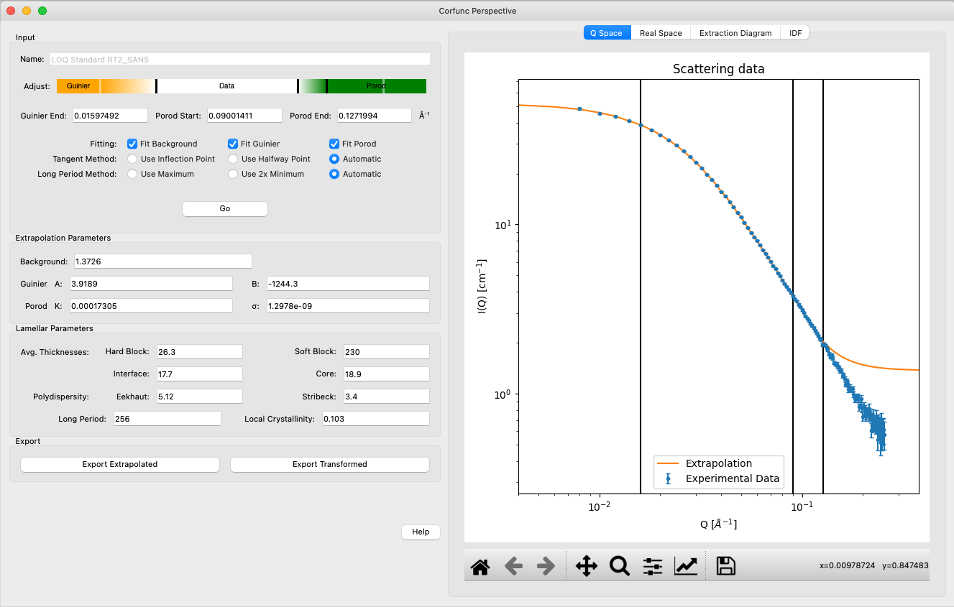
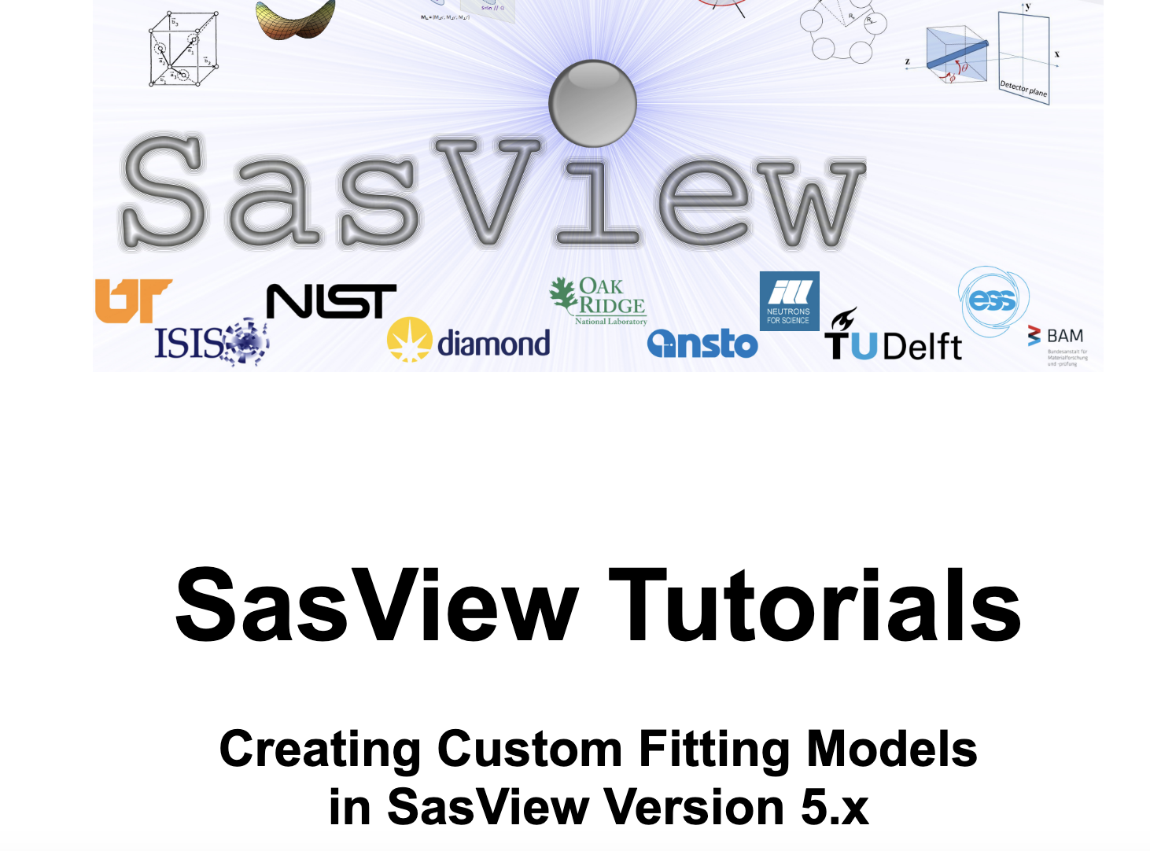
SasView 6.0.0-alpha release
Test at your own risk
Orientation viewer available
Corfunc perspective refactored
Simultaneous fitting allows for a weighting scheme
Preferences panel with display and plotting options
Improved label handling on plots
Residuals plots refactored
PDB reader refactored
Wedge slicer added
Sasdata package separated
Custom Model writing tutorial

Slide 30
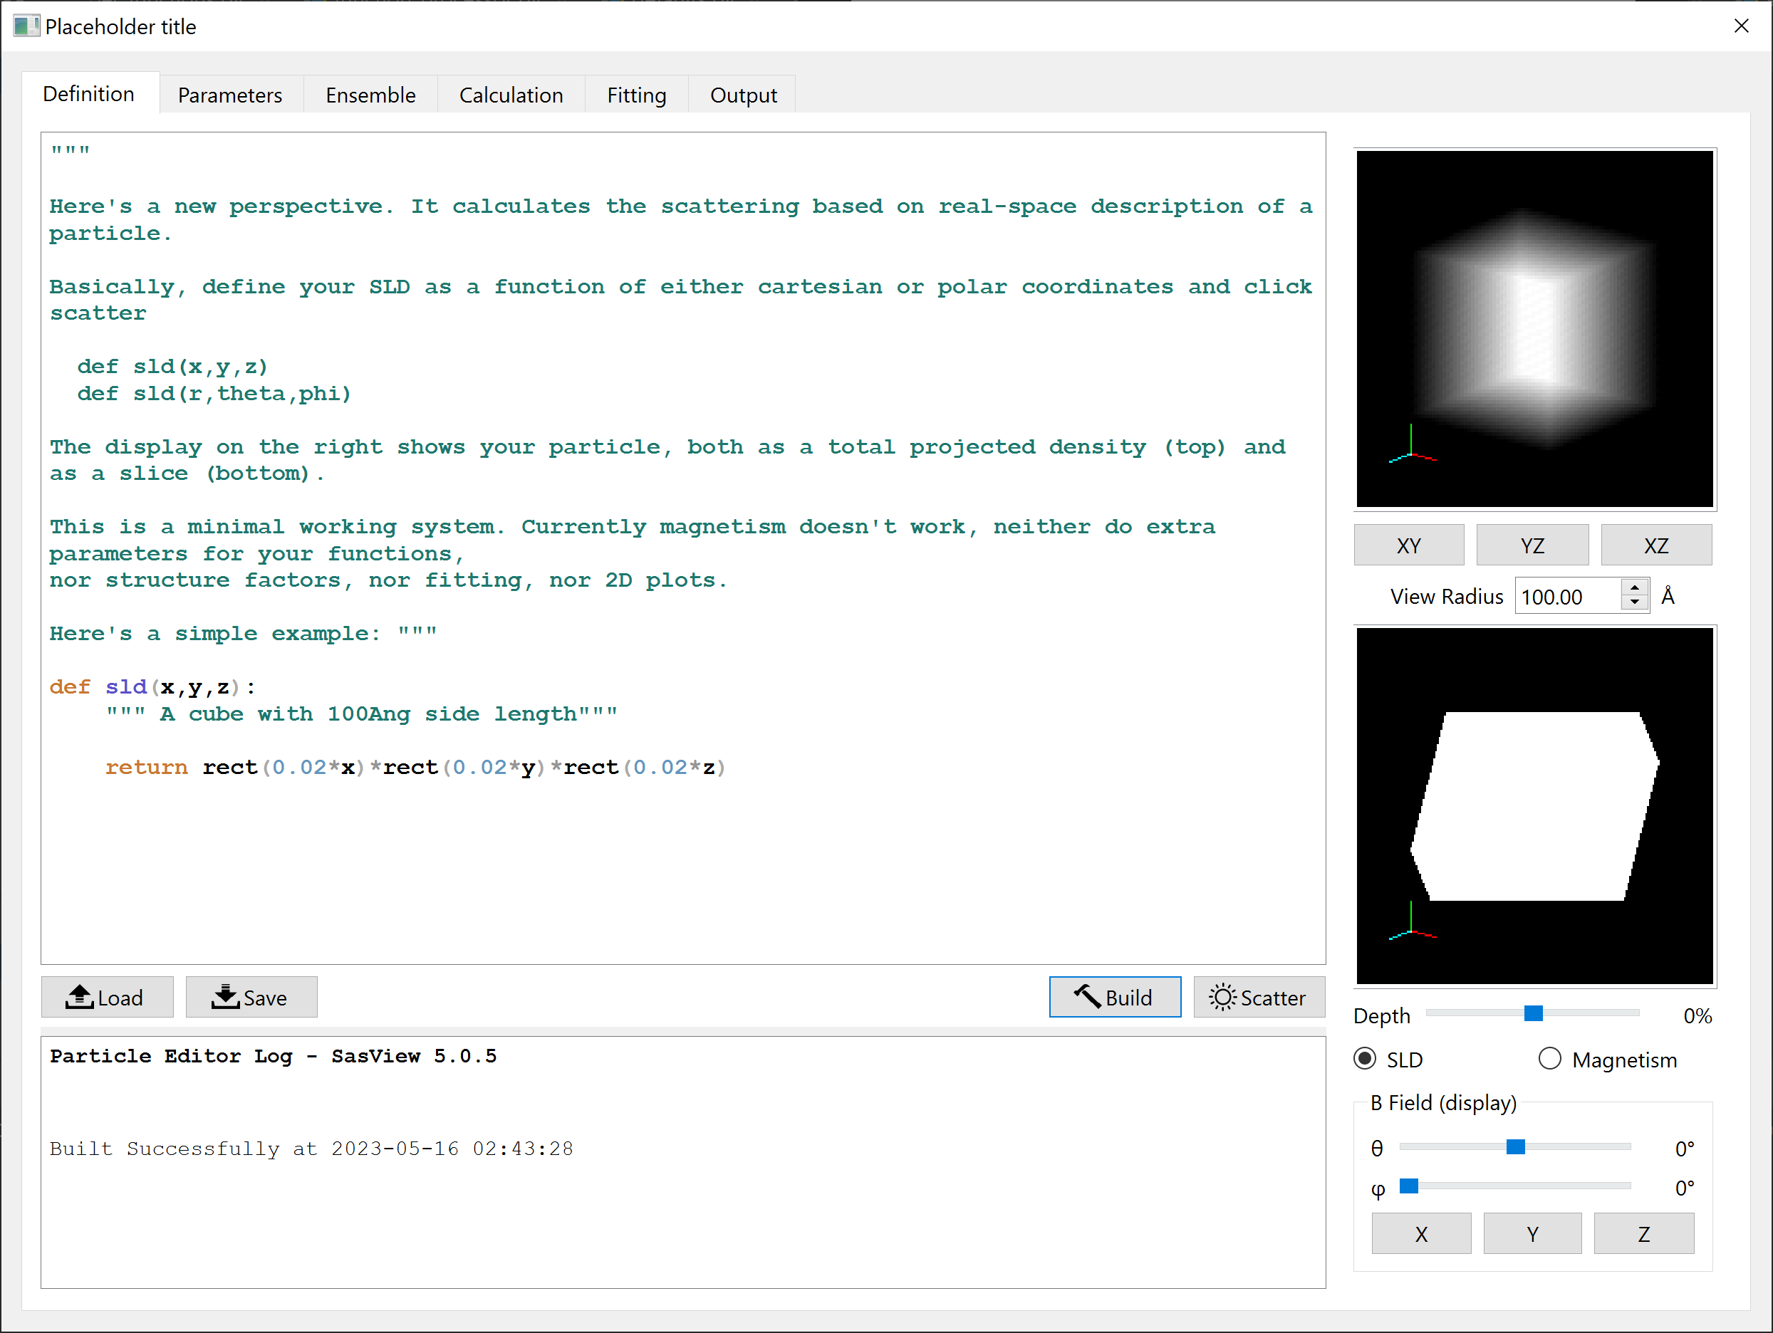
Particle Editor
Features beyond SasView-6.0.0
Define functions
sld and (optionally)
magnetism
sld / magnetism
“x-ray” projection
sld / magnetism
cross section
Feedback on
code and calculations
Magnetic field
controls for display
“Recompile” and
update display
Compute
scattering
Lucas Willkins (ISIS)

Slide 31
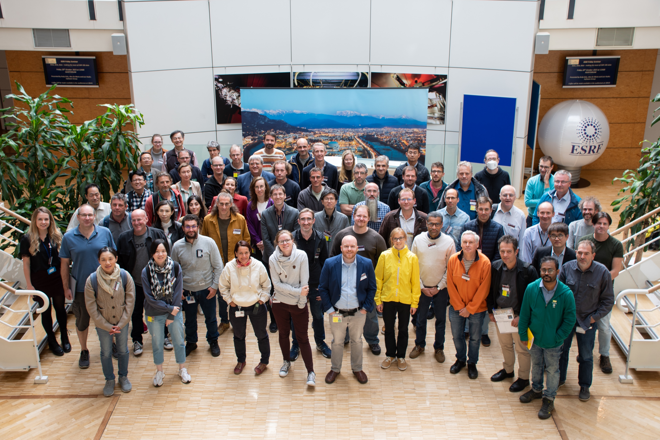
Towards generic resolution function
CanSAS- Collective action for nomadic Small Angle Scatterers
CanSAS meeting, Grenoble, Oct 2023

Slide 32
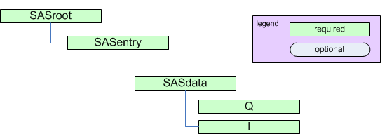
NxCanSAS format
Standard to reduced SAS data of any dimension
https://manual.nexusformat.org/classes/applications/NXcanSAS.html

Slide 33
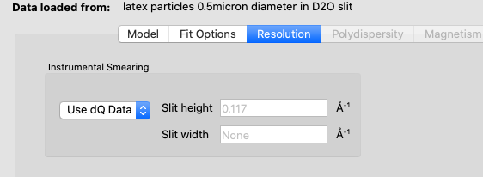
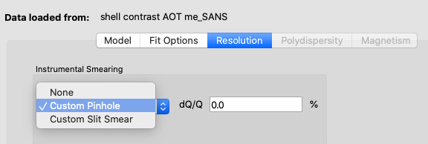
Towards generic resolution function
Example of what is currently available
Data reduction (resolution values)
File with q, I(q), dI, dQ
Data Analysis (reads in dQ from file)
In SasView:
File with dQ
<Idata>
<Q unit="1/A">0.00714</Q>
<I unit="1/cm">226.539</I>
<Idev unit="1/cm">1.93973</Idev>
<Qdev unit="1/A">0.00144239</Qdev>
</Idata>
File without dQ

Slide 34
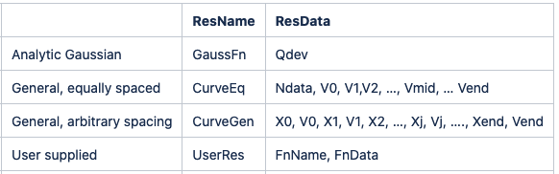
Towards generic resolution function
Ideas for extensions in NXCanSAS format
NXCanSAS placeholders:
/entry/data/q/resolutions
Dataset name corresponding to Q resolution data
/entry/data/q/resolutions_description
Can be a simple description (i.e. Gaussian) or metadata on Q resolution data
Notes:
We will presume that a CanSAS hdf format file is going to be used. The normal historic “Gaussian equivalent” standard deviation provided by an instrument Qdev(Q) should always be provided

Slide 35
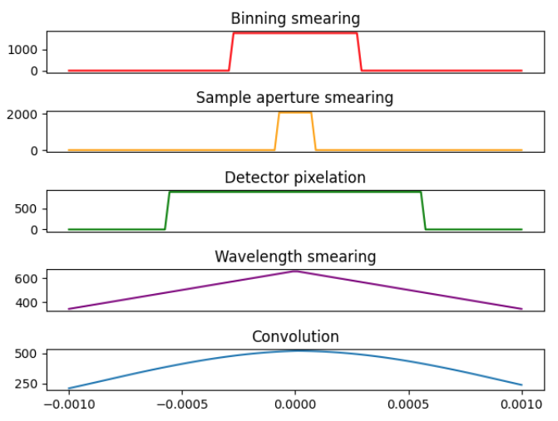
Towards generic resolution function
Status and future outlook
Proof of concept in SasView (utilizing temporary format in script)
Resolution kernel convolution (aka GRASP)
Adapting data reduction software to produce per-q resolution functions
Store resolution function to NXCanSAS file
Demo for Working Group
Outstanding questions:
GUI support
2D resolution
DONE
IN PROGRESS
TODO
TO BE DECIDED

Slide 36
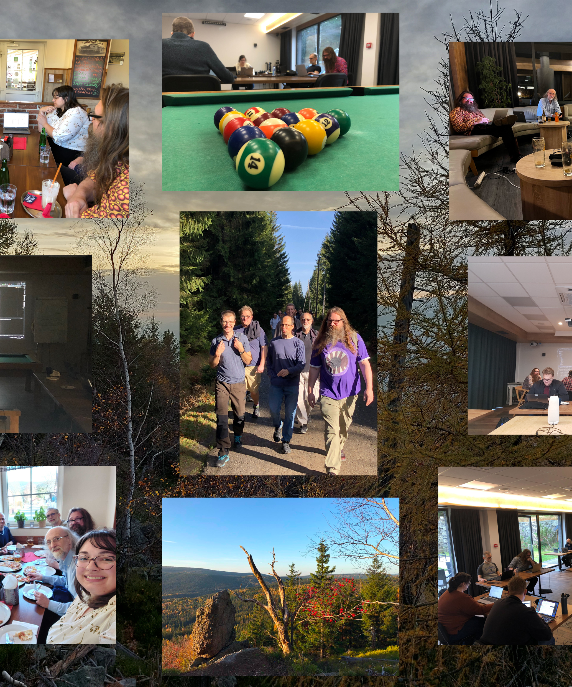
Collaboration
The SasView approach

Slide 37
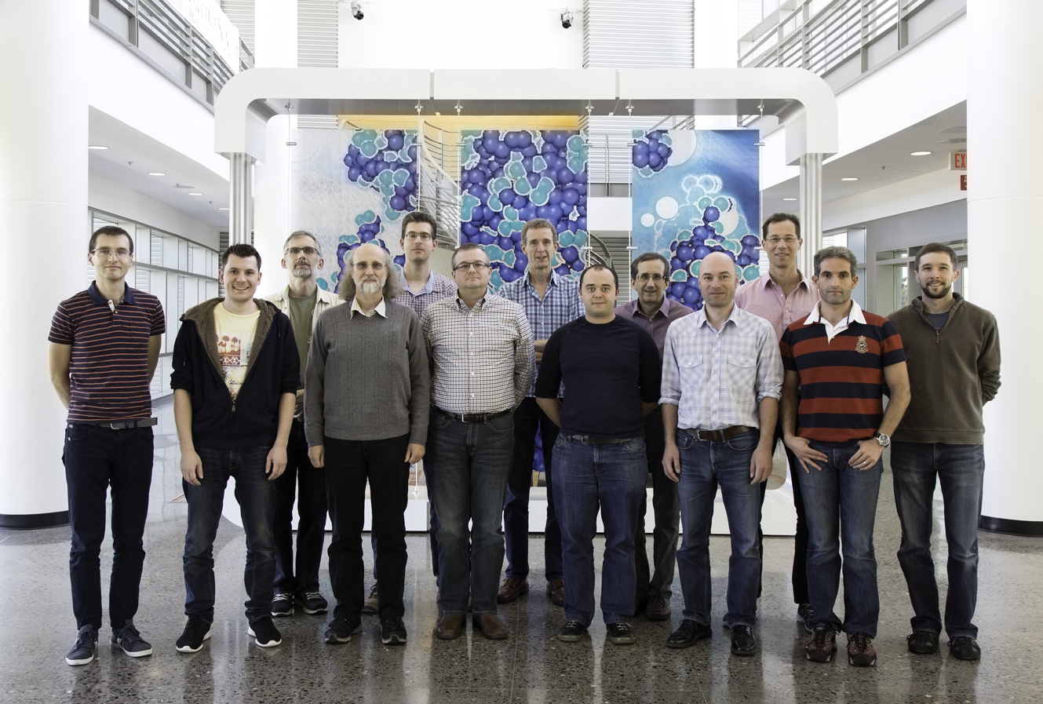
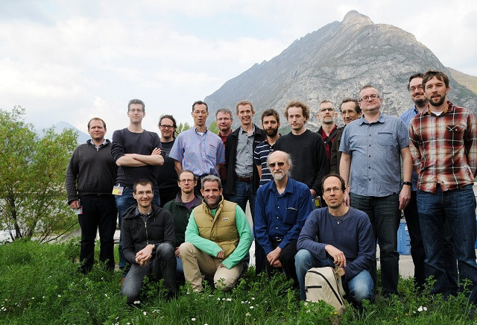
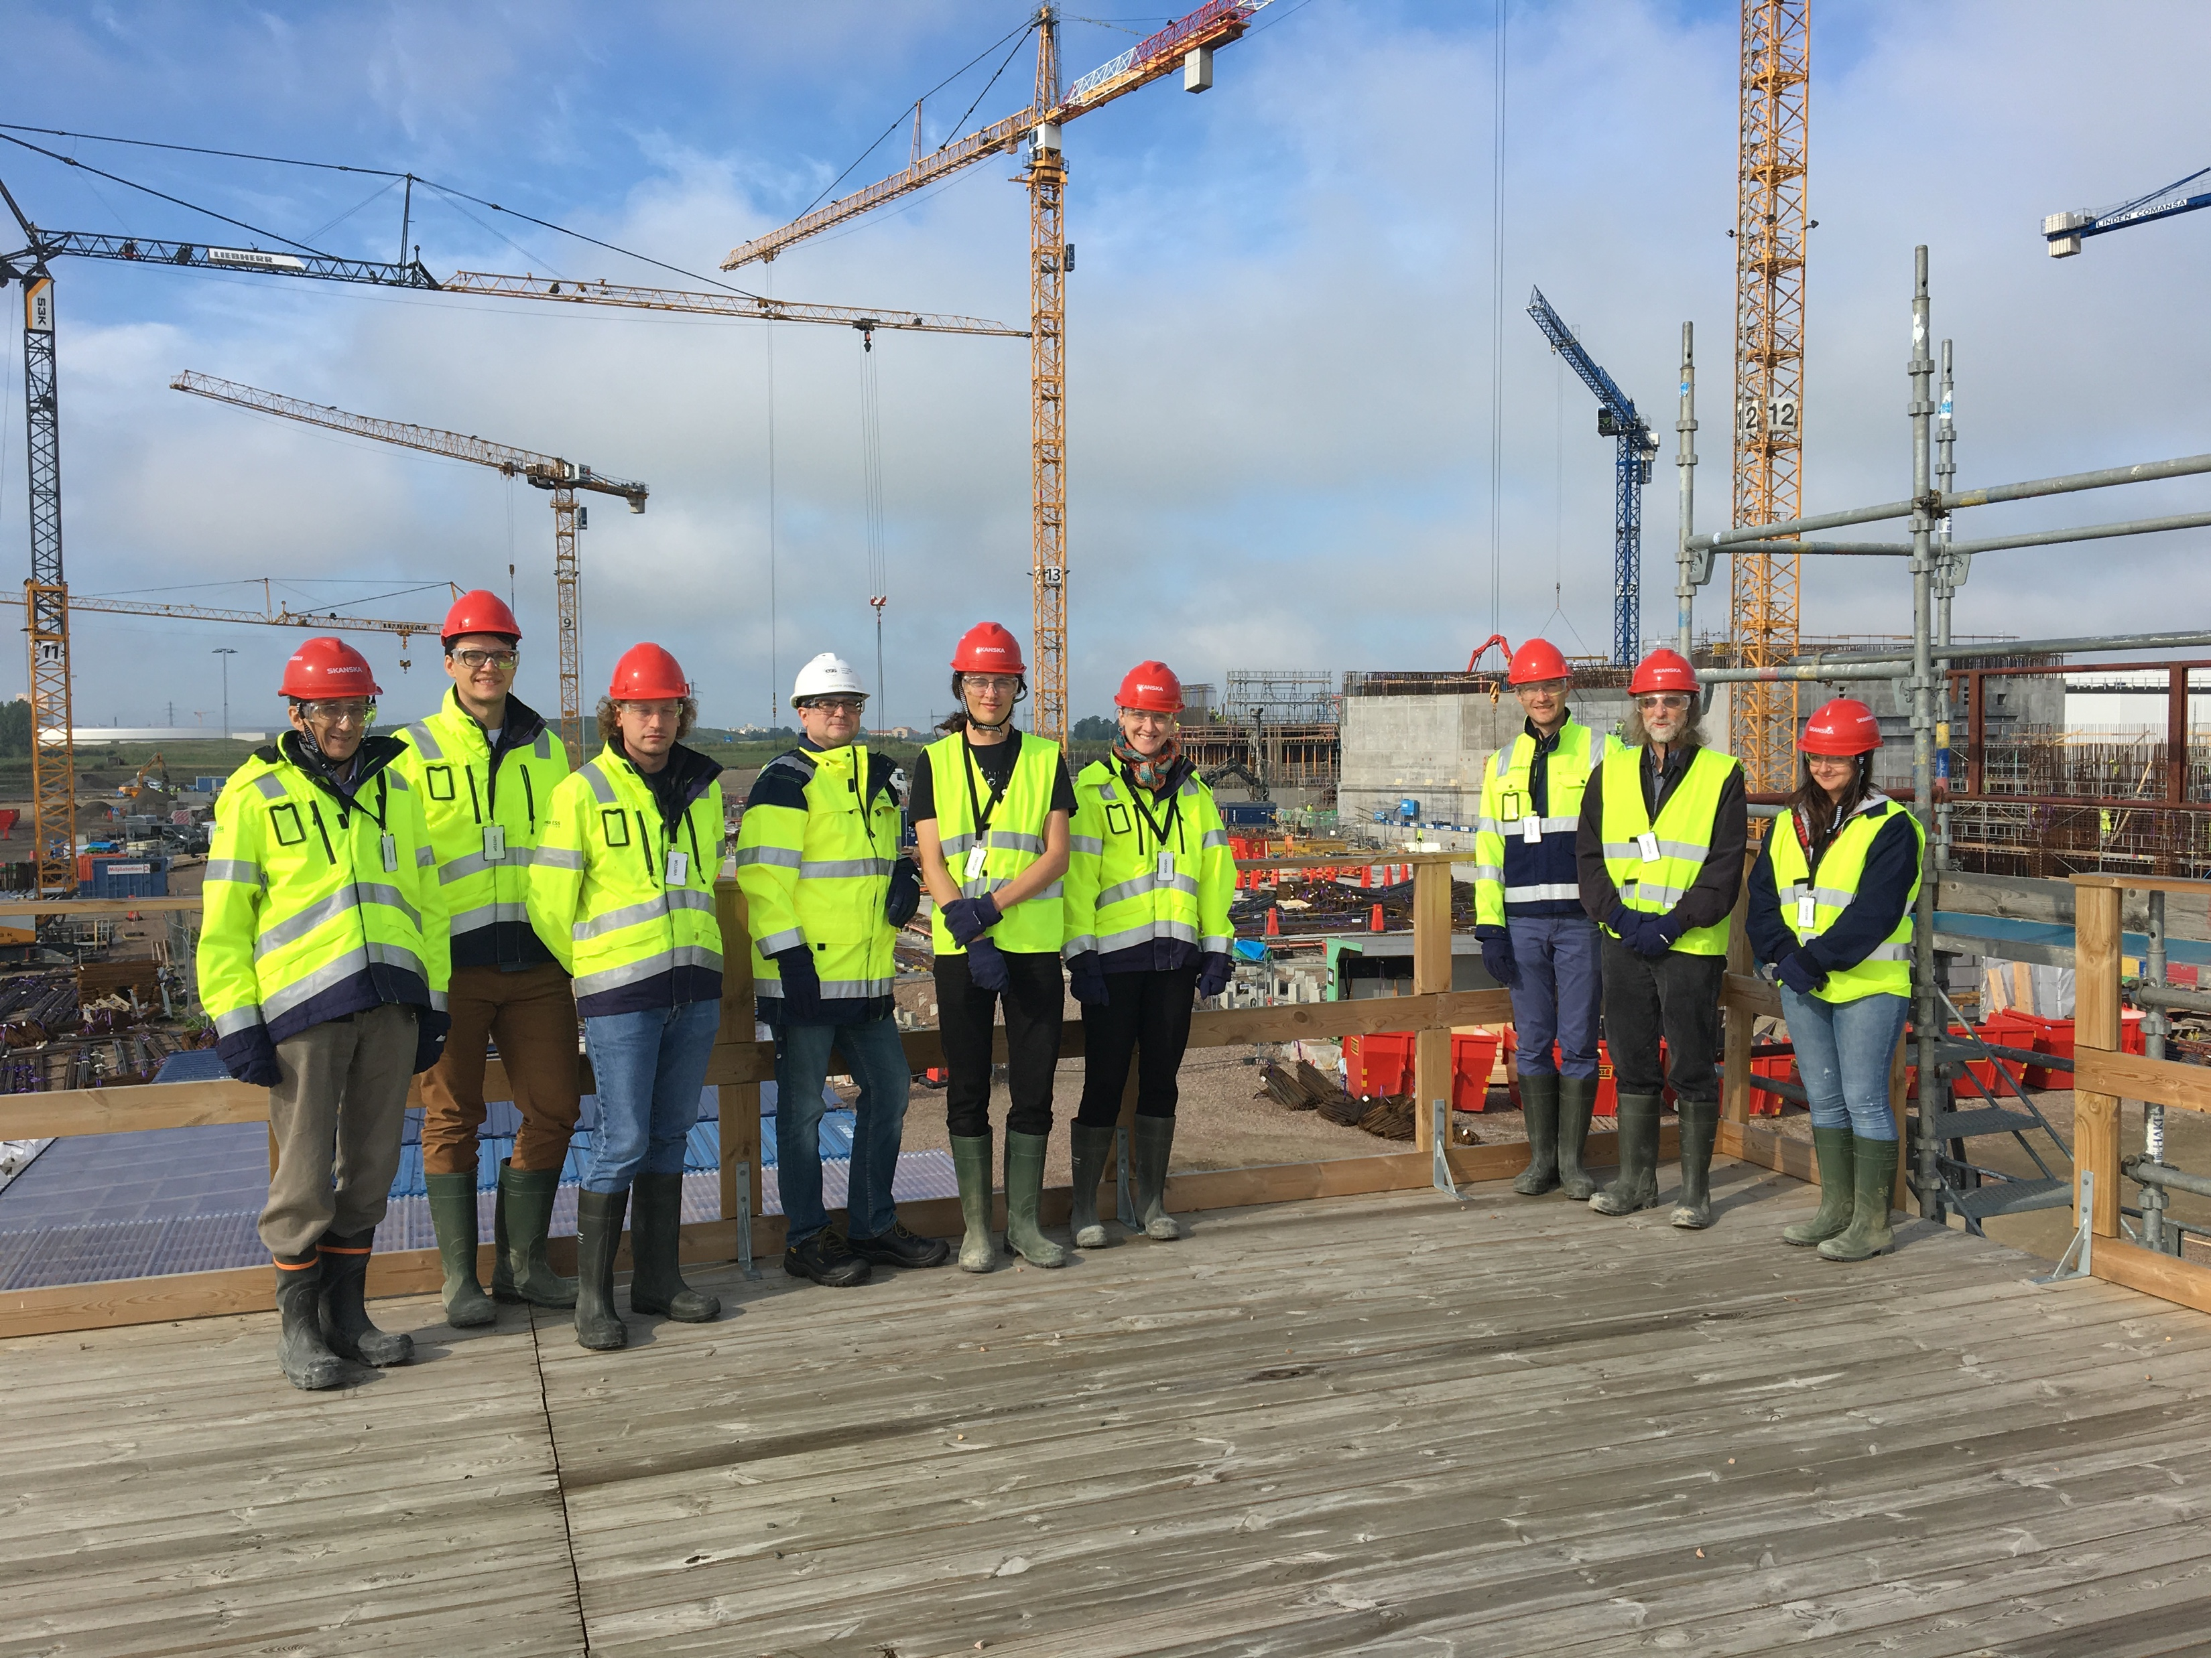
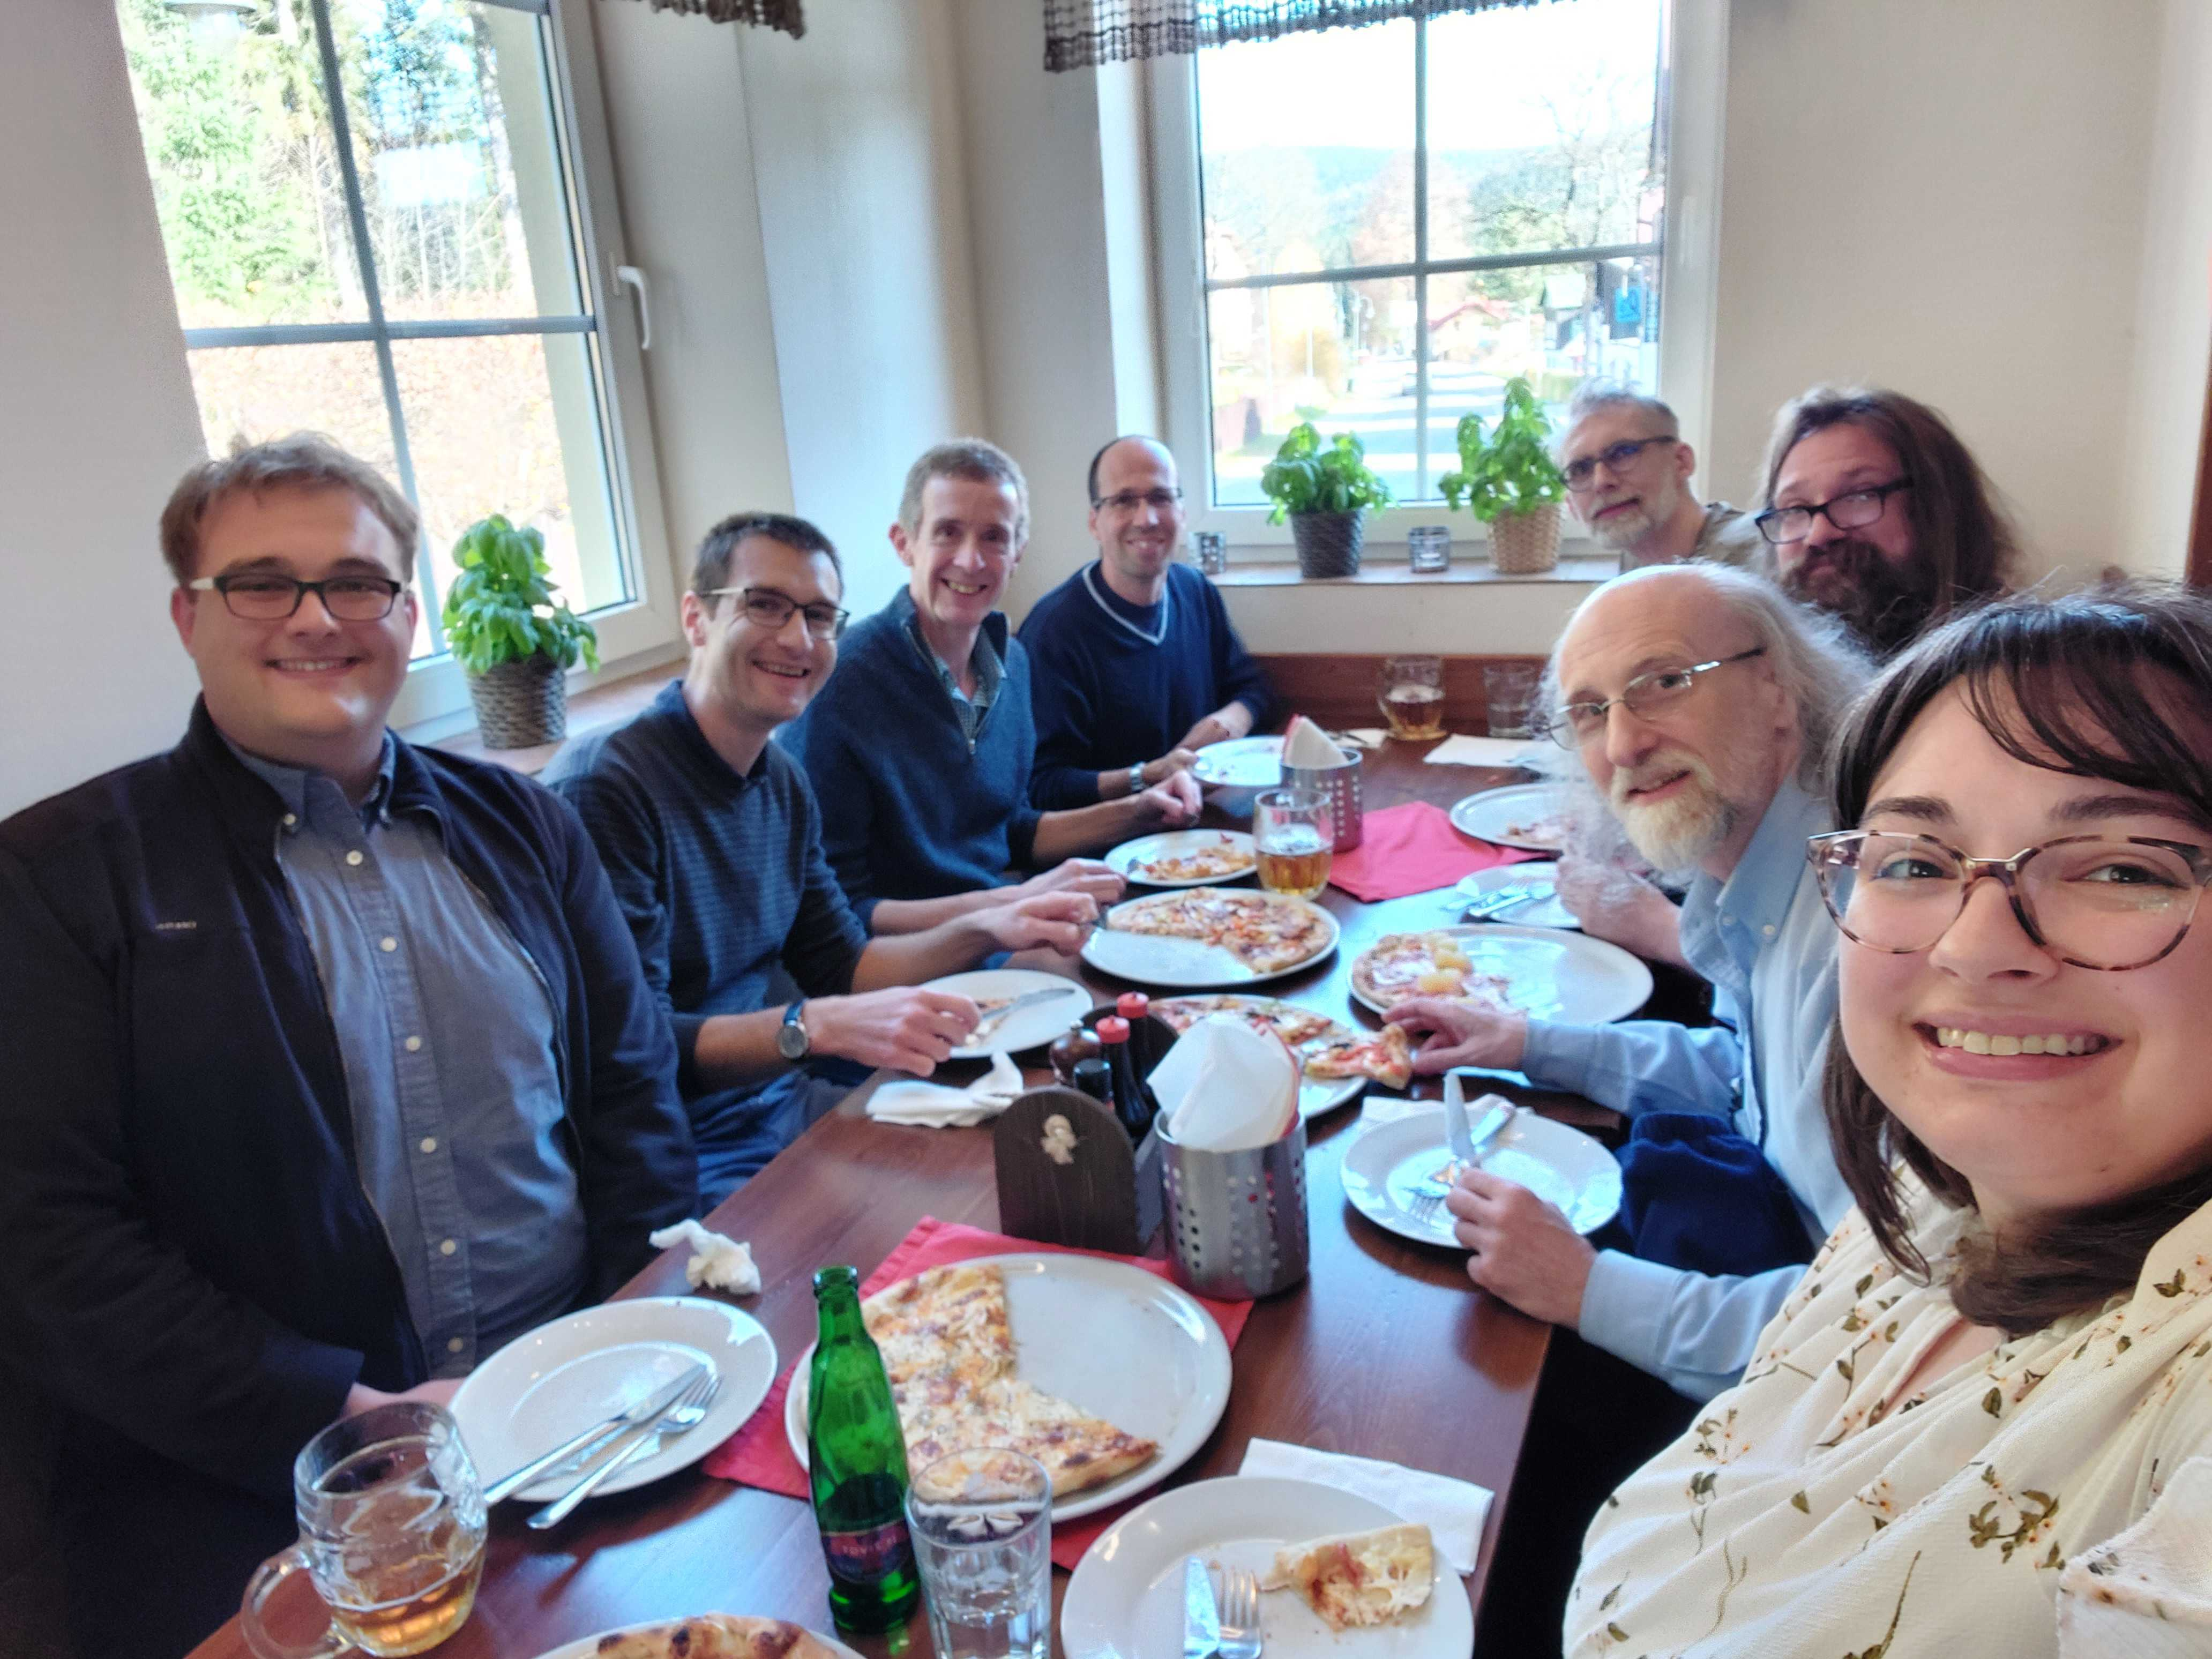
The SasView approach
An open, collaborative, community development
Community driven project
Supported by 9 facilities, 40 contributors (~15 active at any one time)
Small leadership team: Paul Butler (NIST), Steve King (ISIS), Wojciech Potrzebowski (ESS)
Biweekly calls
Regular SasView camps and hackathons
Hosted on github: https://github.com/SasView/sasview
Pictures from Code Camps: V, VI, VIII, X
www.sasview.org

Slide 38
SasView collaboration
Basic rules
Those who bring the resources (time, effort, funds) choose what to work on
but cannot break existing experiences ...

Slide 39
How to contribute
You don’t have to be coding ninja to help out!
Respond to queries posted to help@sasview.org or github
Teach others how to get the best from SasView
Write and improve documentation
Write and record tutorials
Test SasView (over and over!) and write bug reports
Provide new plugin models
Deploy and improve automated testing
Review the code contributions of others
Develop code in Python3/C and PyQt/Matplotlib
www.sasview.org/contribute

Slide 40



Resources for contributors
Reducing entry barier and improving release cycles frequency
Faster release cycles
E-learning course
Contributor Camp
Save the date!
Jan 16th – 22nd 2024
University of Delaware, US
https://e-learning.pan-training.eu/course/view.php?id=52

Slide 41




Other resources for users and developers
Documentation and communication channels
Website
Documentation
in-program & online
Written Tutorials
Video Tutorials (YouTube)
Taught Courses
scattering schools/workshops
university courses
Bootcamps & regional workshops
e-Learning
Slack
Twitter
(Marketplace)
help@sasview.org
users@sasview.org

Slide 42

Where to start?
www.sasview.org
Please download and run it before the tutorial tomorrow!

Slide 43


Slide 44

Merci
On behalf of SasView community
https://zenodo.org/records/7581379

